Slide 1
Week 14–
Giant Sized Faith

Slide 2
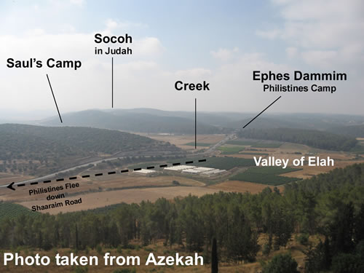

Slide 3
Symptoms of a shrunk down God:
Praying without faith
Serving without passion
Questioning God’s character

Slide 4
David never saw the giant in Goliath. The only giant David focused on was the one, true living God.

Slide 5
Big Idea:
Don’t tell God how big your giants are. Tell your giants how big God is.

Slide 6
Prayer #1:
God, help us to live with passion for Your glory among our local and global neighbors!

Slide 7
Prayer #2:
God, help us to live with confidence in Your power!

Slide 8
Prayer #3:
God, help us to look to Jesus as our champion!

Slide 9
God, help us to live with passion for Your glory among our local and global neighbors!
God, help us to live with confidence in Your power!
God, help us to look to Jesus as our champion!

