Slide 1
Week 22–
Walking in Wisdom

Slide 2
Question:
“What is the one thing you want Me to give you?”

Slide 3
A proverb is a guideline for living life, not a guarantee.

Slide 4
Submission precedes direction

Slide 5
God does not give direction for consideration but for our participation in knowing Him.

Slide 6
“The fear of the LORD is the beginning of knowledge.” – Proverbs 1:7
“The fear of the LORD is the beginning of wisdom.” – Proverbs 9:10

Slide 7
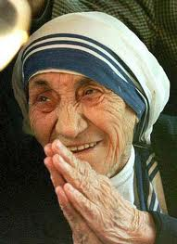
“Clarity is the last thing you are clinging to and must let go of.”

