Slide 1
Week 32–
Questioning God

Slide 2
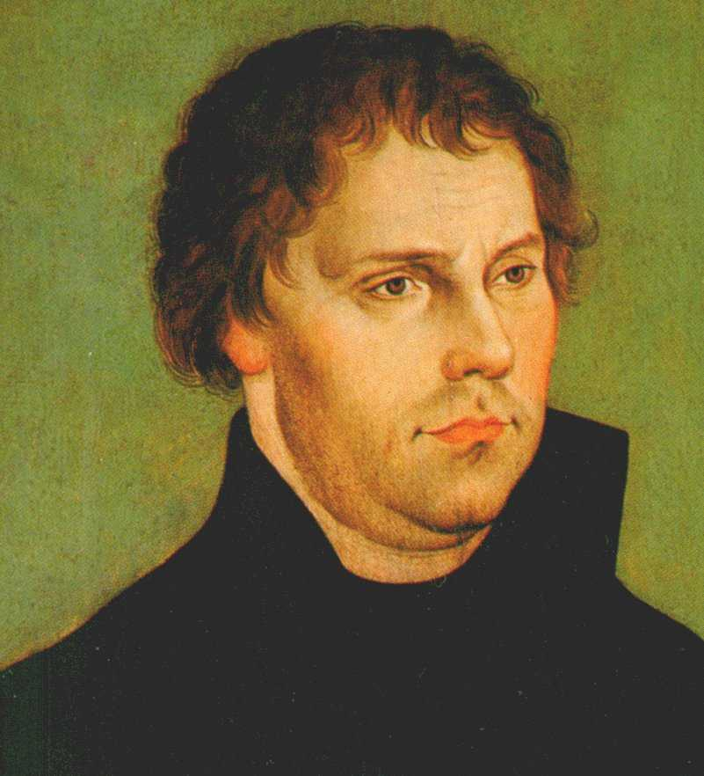
Martin Luther (1483 – 1546)

Slide 3
1) God, You don’t seem to care about me
2) God, You are not doing what You should be doing
3) God, what You are doing doesn’t seem to be fair or to be working

Slide 4
Listen to the Truth of God

Slide 5
Lean on the Timing of God

Slide 6
Short-term circumstances provide a poor measurement of God’s long-term never changing character

Slide 7
But the Lord is in His Holy Temple

Slide 8
Live with your Trust in God

Slide 9
Week 32–
Questioning God

