Slide 1
The Alpha and the Omega The Beginning and the End

Slide 2
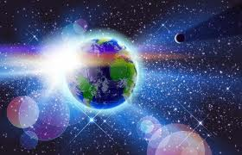
Genesis – The “Alpha”
Genesis 1:1
“In the beginning God created the heavens and the earth.”

Slide 3
Revelation – The “Omega”
Written in AD 95
Author: John the Apostle
Fisherman
Close companion of Jesus
Cared for Mary, Jesus’ mother
Spiritual father to churches
Exiled to Island of Patmos at 80-90 years old

Slide 4
The Revelation of Jesus Christ
Revelation 1:1-3
“The Revelation of Jesus Christ, which God gave Him to show to His bond-servants, the things which must soon take place; and he sent and communicated it by His angel to His bond-servant John, who testified to the word of God and to the testimony of Jesus Christ, even to all that he saw. Blessed is he who reads and those who hear the words of the prophecy, and heed the things which are written in it; for the time is near.”

Slide 5
The Revelation of Jesus Christ
Revelation 1:1-3
“The Revelation of Jesus Christ, which God gave Him to show to His bond-servants, the things which must soon take place; and he sent and communicated it by His angel to His bond-servant John, who testified to the word of God and to the testimony of Jesus Christ, even to all that he saw. Blessed is he who reads and those who hear the words of the prophecy, and heed the things which are written in it; for the time is near.”

Slide 6
The Revelation of Jesus Christ
Revelation 1:1-3
“The Revelation of Jesus Christ, which God gave Him to show to His bond-servants, the things which must soon take place; and he sent and communicated it by His angel to His bond-servant John, who testified to the word of God and to the testimony of Jesus Christ, even to all that he saw. Blessed is he who reads and those who hear the words of the prophecy, and heed the things which are written in it; for the time is near.”

Slide 7
The Revelation of Jesus Christ
Revelation 1:1-3
“The Revelation of Jesus Christ, which God gave Him to show to His bond-servants, the things which must soon take place; and he sent and communicated it by His angel to His bond-servant John, who testified to the word of God and to the testimony of Jesus Christ, even to all that he saw. Blessed is he who reads and those who hear the words of the prophecy, and heed the things which are written in it; for the time is near.”

Slide 8
The Revelation of Jesus Christ
Revelation 1:1-3
“The Revelation of Jesus Christ, which God gave Him to show to His bond-servants, the things which must soon take place; and he sent and communicated it by His angel to His bond-servant John, who testified to the word of God and to the testimony of Jesus Christ, even to all that he saw. Blessed is he who reads and those who hear the words of the prophecy, and heed the things which are written in it; for the time is near.”

Slide 9
The Revelation of Jesus Christ
Revelation 1:1-3
“The Revelation of Jesus Christ, which God gave Him to show to His bond-servants, the things which must soon take place; and he sent and communicated it by His angel to His bond-servant John, who testified to the word of God and to the testimony of Jesus Christ, even to all that he saw. Blessed is he who reads and those who hear the words of the prophecy, and heed the things which are written in it; for the time is near.”

Slide 10
The Revelation of Jesus Christ
Revelation 1:1-3
“The Revelation of Jesus Christ, which God gave Him to show to His bond-servants, the things which must soon take place; and he sent and communicated it by His angel to His bond-servant John, who testified to the word of God and to the testimony of Jesus Christ, even to all that he saw. Blessed is he who reads and those who hear the words of the prophecy, and heed the things which are written in it; for the time is near.”

Slide 11
The Revelation of Jesus Christ Chapter Overview
Chapter 1: Christ -> John -> Bond-servants
Chapter 2-3: Overcome! Be Ready!
Chapter 4: God is still on His throne
Chapter 5: The Lamb is Worthy
Chapter 6-16: God’s Wrath Poured Out
Chapter 17-20: Judgment of this World &
Marriage of the Lamb
Chapter 21-22: New Heavens & New Earth

Slide 12
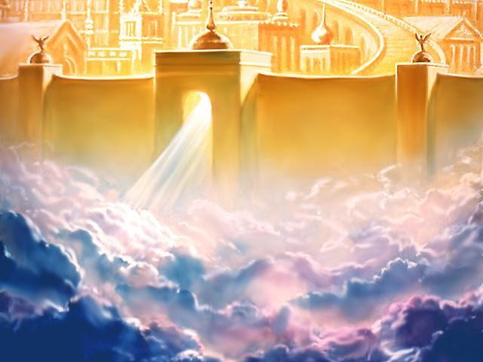
The Revelation of Jesus Christ
Revelation 21:1-7

Slide 13
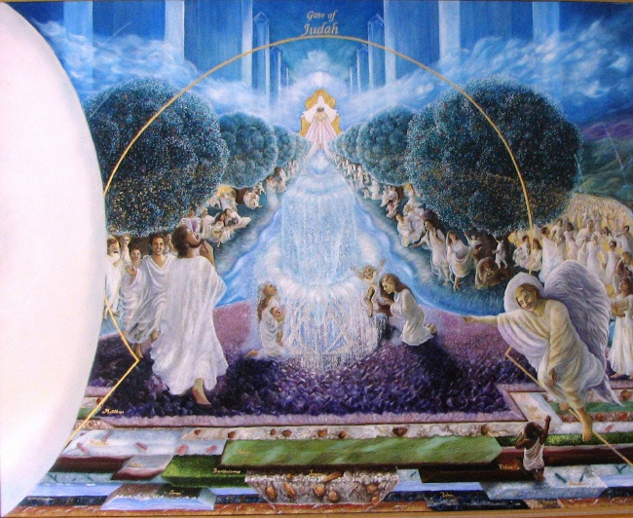
The Revelation of Jesus Christ
Revelation 22:1-5

Slide 14
Genesis vs. Revelation
Heavens & earth created
Adam & Eve live there
Live in a garden
God walks with them
Sun, moon and stars give light
The new heaven & earth come from heaven
His bride, people from all nations live there
Live in the holy city, new Jerusalem
God & the Lamb dwell among His people
God & Lamb are its light

Slide 15
Genesis vs. Revelation
Could eat from all trees (but 1)
River flowed out of it
Satan/serpent lives among them
Knew death, pain, mourning
Mankind and creation cursed
Were expelled from the garden
Tree of Life produces 12 kinds of fruit
River of the water of life comes from the throne of God & the Lamb
Satan has been judged, and nothing evil is allowed in the city
No longer any death, crying, pain, mourning
No longer any curse, all are made new
Will live with God forever

Slide 16
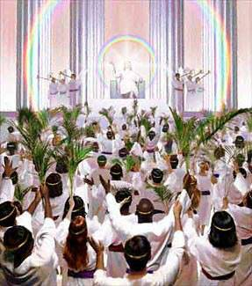
Getting Personal…
Will you be with Him in the new heaven and earth?
Mark 8:34-38

Slide 17
Christ is coming quickly!
Revelation 22:12-14, 17, 20
“Behold, I am coming quickly, and My reward is with Me, to render to every man according to what he has done.
“I am the Alpha and the Omega, the first and the last, the beginning and the end.”
Blessed are those who wash their robes, so that they may have the right to the tree of life, and may enter by the gates into the city.
The Spirit and the bride say, “Come.” And let the one who hears say, “Come.” And let the one who is thirsty come; let the one who wishes, take the water of life without cost.
He who testifies to these things says, “Yes, I am coming quickly.”
Amen. Come, Lord Jesus.

