Slide 1
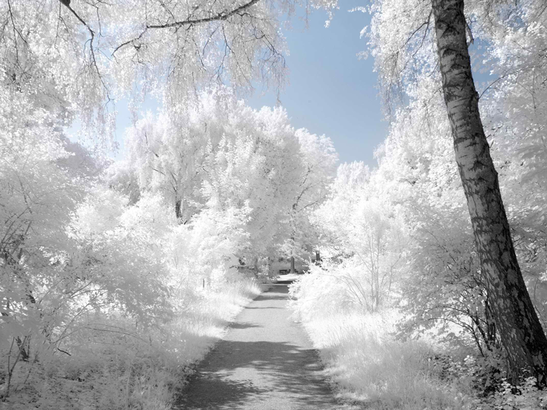
Sandy Ridge Community Church
Who is this baby
and what does He mean to us?
Frank Jones
December 21, 2014

Slide 2
Isaiah 7:14
¹⁴ Therefore the Lord himself will give you a sign: The virgin will conceive and give birth to a son, and will call him Immanuel.

Slide 3
Isaiah 9:6
⁶ For to us a child is born, to us a son is given, and the government will be on his shoulders. And he will be called Wonderful Counselor, Mighty God, Everlasting Father, Prince of Peace.

Slide 4
Micah 5:2
² “But you, Bethlehem Ephrathah, though you are small among the clans of Judah, out of you will come for me one who will be ruler over Israel, whose origins are from of old, from ancient times.”

Slide 5
John 8:58
⁵⁸ "Very truly I tell you," Jesus answered, "before Abraham was born, I am!"

Slide 6
Matt 1:22-23
²² Now all this took place to fulfill what was spoken by the Lord through the prophet:
²³ “Behold, the virgin shall be with child and shall bear a son, and they shall call his name Immanuel,” which translated means, “GOD WITH US.”
Isaiah 7:14
¹⁴ Therefore the Lord himself will give you a sign: The virgin will conceive and give birth to a son, and will call him Immanuel.
Notes:
This Slide Has Animation. Press Enter to see the 2nd box with Exodus 3:14

Slide 7
Micah 5:2
² “But you, Bethlehem Ephrathah, though you are small among the clans of Judah, out of you will come for me one who will be ruler over Israel, whose origins are from of old, from ancient times.”
Matt 2:1-6
¹After Jesus was born in Bethlehem in Judea, during the time of King Herod, Magi from the east came to Jerusalem
²and asked, “Where is the one who has been born king of the Jews? We saw his star when it rose and have come to worship him.”
Notes:
This Slide Has Animation. Press Enter to see the 2nd box with Exodus 3:14

Slide 8
Matt 2:1-6
³ When Herod the king heard this, he was troubled, and all Jerusalem with him.
⁴ Gathering together all the chief priests and scribes of the people, he inquired of them where the Messiah was to be born
⁵ In Bethlehem in Judea, they replied, "for this is what the prophet has written”
⁶ “But you, Bethlehem, in the land of Judah, are by no means least among the rulers of Judah; for out of you will come a ruler who will be the shepherd of my people Israel.”
Notes:
This Slide Has Animation. Press Enter to see the 2nd box with Exodus 3:14

Slide 9
John 1:1-4
¹ In the beginning was the Word, and the Word was with God, and the Word was God.
² He was with God in the beginning.
³ Through him all things were made; without him nothing was made that has been made.
⁴ In him was life, and that life was the light of men.

Slide 10
Gen 1:1
¹ In the beginning God created the heavens and the earth.

Slide 11
John 1:3
³ Through him all things were made; without him nothing was made that has been made.
Conclusion:
The Word is also God the Creator
Notes:
Press ENTER to show Conclusion

Slide 12
John 1:14
¹⁴ The Word became flesh and made his dwelling among us. We have seen his glory, the glory of the One and Only, who came from the Father, full of grace and truth.

Slide 13
Rom 9:5
⁵ Theirs are the patriarchs, and from them is traced the human ancestry of Christ, who is God over all, forever praised! Amen.
Philippians 2:5-7
⁵ Your attitude should be the same as that of Christ Jesus:
⁶ Who, being in very nature God, did not consider equality with God something to be grasped, ⁷ but made himself nothing, taking the very nature of a servant, being made in human likeness.
Philippians 2:10-11
¹⁰ that at the name of Jesus every knee should bow, in heaven and on earth and under the earth,¹¹ and every tongue confess that Jesus Christ is Lord, to the glory of God the Father.
Titus 2:13
¹³ while we wait for the blessed hope-- the glorious appearing of our great God and Savior, Jesus Christ,
Notes:
----- Meeting Notes (12/6/14 21:34) -----
THIS SLIDE HAS ANIMATION

Slide 14
John 8:58
⁵⁸ "Very truly I tell you," Jesus answered, "before Abraham was born, I am!"
Exodus 3:14
¹⁴ God said to Moses, "I AM WHO I AM. This is what you are to say to the Israelites: 'I AM has sent me to you.'"
Notes:
This Slide Has Animation. Press Enter to see the 2nd box with Exodus 3:14

Slide 15
John 10:30
³⁰ I and the Father are one.

Slide 16
John 14:6 and 14:9-10
⁶ Jesus said to him, “I am the way, and the truth, and the life; no one comes to the Father but through Me.
⁹ Jesus said to him, “Have I been so long with you, and yet you have not come to know Me, Philip? He who has seen Me has seen the Father; how can you say, ‘Show us the Father’? ¹⁰ “Do you not believe that I am in the Father, and the Father is in Me? The words that I say to you I do not speak on My own initiative, but the Father abiding in Me does His works.

Slide 17
Matt 16:16
¹⁶ Simon Peter answered, "You are the Messiah, the Son of the living God."

Slide 18
Romans 8:28
²⁸ And we know that in all things God works for the good of those who love him, who have been called according to his purpose.

Slide 19
Romans 8:29-30
²⁹ For those God foreknew he also predestined to be conformed to the image of his Son, that he might be the firstborn among many brothers and sisters. ³⁰ And those he predestined, he also called; those he called, he also justified; those he justified, he also glorified.

Slide 20
GRACE
God’s
Riches
At
Christ’s
Expense

Slide 21
Romans 8:31-34
³¹ What, then, shall we say in response to these things? If God is for us, who can be against us? ³² He who did not spare his own Son, but gave him up for us all - how will he not also, along with him, graciously give us all things? ³³ Who will bring any charge against those whom God has chosen? It is God who justifies. ³⁴ Who then is the one who condemns? No one. Christ Jesus who died - more than that, who was raised to life - is at the right hand of God and is also interceding for us.

Slide 22
Philippians 4:19
¹⁹ And my God will meet all your needs according to the riches of his glory in Christ Jesus.

Slide 23
Romans 8:35-39
³⁵ Who shall separate us from the love of Christ? Shall trouble or hardship or persecution or famine or nakedness or danger or sword? ³⁶ As it is written:
“For your sake we face death all day long; we are considered as sheep to be slaughtered.”
³⁷ No, in all these things we are more than conquerors through him who loved us. ³⁸ For I am convinced that neither death nor life, neither angels nor demons, neither the present nor the future, nor any powers, ³⁹ neither height nor depth, nor anything else in all creation, will be able to separate us from the love of God that is in Christ Jesus our Lord.
Notes:
----- Meeting Notes (12/6/14 21:34) -----
THIS SLIDE HAS ANIMATION

Slide 24
Sandy Ridge Mission Statement
Our mission is the foundation which guides all that we do. We exist to learn to live and love more like Jesus by allowing the power of His Holy Spirit to flow through us so that:
Seekers develop into followers of Him; Followers develop into participants in His kingdom; Participants develop into growing, life-long disciples; Disciples engage with the local and global community to bless others in His Name; And all of this to be done for the glory of God.
Personal Mission Ministry Statement

Slide 25
Adam & Eve- Genesis 1:28
²⁸ God blessed them and said to them, “Be fruitful and increase in number; fill the earth and subdue it. Rule over the fish in the sea and the birds in the sky and over every living creature that moves on the ground.”
Personal Mission Ministry Statement

Slide 26
Moses- Exodus 3:10
¹⁰ So now, go. I am sending you to Pharaoh to bring my people the Israelites out of Egypt.”
Personal Mission Ministry Statement

Slide 27
Joshua 1:2
² Moses my servant is dead. Now then, you and all these people, get ready to cross the Jordan River into the land I am about to give to them - to the Israelites.
Personal Mission Ministry Statement

Slide 28
David - 2 Samuel 5:2 and 7:8
^{5:2} In the past, while Saul was king over us, you were the one who led Israel on their military campaigns. And the Lord said to you, ‘You will shepherd my people Israel, and you will become their ruler.’
^{7:8} Now then, tell my servant David, This is what the Lord Almighty says: I took you from the pasture, from tending the flock, and appointed you ruler over my people Israel.
Personal Mission Ministry Statement

Slide 29
Nehemiah 2:17-18
¹⁷ Then I said to them, “You see the trouble we are in: Jerusalem lies in ruins, and its gates have been burned with fire. Come, let us rebuild the wall of Jerusalem, and we will no longer be in disgrace.”
¹⁸ I also told them about the gracious hand of my God on me and what the king had said to me. They replied, “Let us start rebuilding.” So they began this good work.
Personal Mission Ministry Statement

Slide 30
Jesus - Matt 20:28; Mark 10:45
^{Matt 20:28} just as the Son of Man did not come to be served, but to serve, and to give his life as a ransom for many.
^{Mark 10:45} For even the Son of Man did not come to be served, but to serve, and to give his life as a ransom for many.
Personal Mission Ministry Statement

Slide 31
Paul- Acts 20:24 and 2Tim 3:10
^{Acts 20:24} However, I consider my life worth nothing to me; my only aim is to finish the race and complete the task the Lord Jesus has given me—the task of testifying to the good news of God’s grace.
^{2 Tim 3:10} You, however, know all about my teaching, my way of life, my purpose, faith, patience, love, endurance,
Personal Mission Ministry Statement

Slide 32
Chuck
My desire is to be the hands and feet of Jesus.
To freely and joyfully give my time, resources, talents and love to everyone around me.
Personal Mission Ministry Statement

Slide 33
Chuck
Christ has no body on Earth but yours,
No hands but yours,
No feet but yours.
Yours are the eye through which Christ’s compassion for the world is to look out.
Yours are the feet with which He is to go about doing good;
And yours are the hands with which He is to bless us now.
~St. Teresa of Avila
My desire is to be the hands and feet of Jesus.
To freely and joyfully give my time, resources, talents and love to everyone around me.
Personal Mission Ministry Statement

Slide 34
Kathi
"To make a positive difference in my little corner of the world by planting and watering seeds of faith - to not-yet Christians and by encouraging Christ-followers to grow in their knowledge of and passion for the Lord."
Summed up - To make a positive difference in my little corner of the world!
Personal Mission Ministry Statement

Slide 35
Frank
My desire is to be used of God, to bring believers into a closer relationship with Him, by being transparent about my walk.
My Slogan - Build relationships through transparency
Personal Mission Ministry Statement

Slide 36
Who is this baby
and what does He mean to us?
THINK BIG.
NO SMALL THINKING ALLOWED
Personal Mission Ministry Statement

Slide 37
Sandy Ridge Community Church
Who is this baby
and what does He mean to us?
Frank Jones
December 21, 2014

