Slide 1
Week 2– The Plan

Slide 2
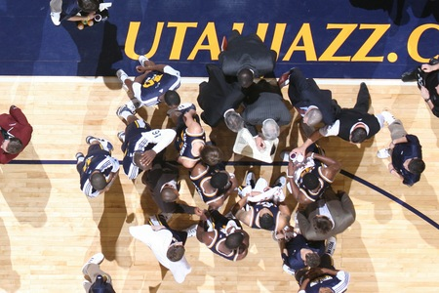
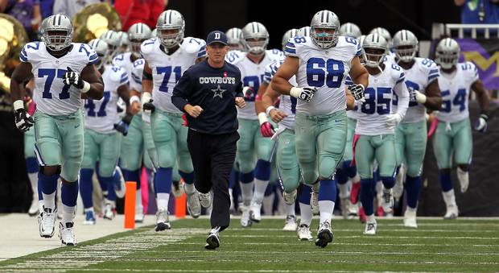

Slide 3
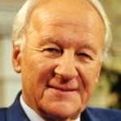
“It may truly be said without exaggeration that no only the rest of the old testament, but also the whole of the New testament are an outworking of these promises of God” - John Stott

Slide 4
Promise #1:
I will make you (Abram) into a great nation

Slide 5
Promise #2:
I will make your name great

Slide 6
Promise #3:
All people groups on earth will be blessed through you

Slide 7
Question:
How are you using God’s blessing to benefit those in your local and global communities

Slide 8
Question:
Do you trust Me?

Slide 9
Question:
Can you worship and trust God even when He is not obligated to explain His actions to you?

