Slide 1
Week 13–
How God Redeems

Slide 2
Redemption:
To restore someone or something to its original intent

Slide 3
Question:
How does Jesus’ resurrection, a historical event 2,000 years ago, impact my everyday life?

Slide 4
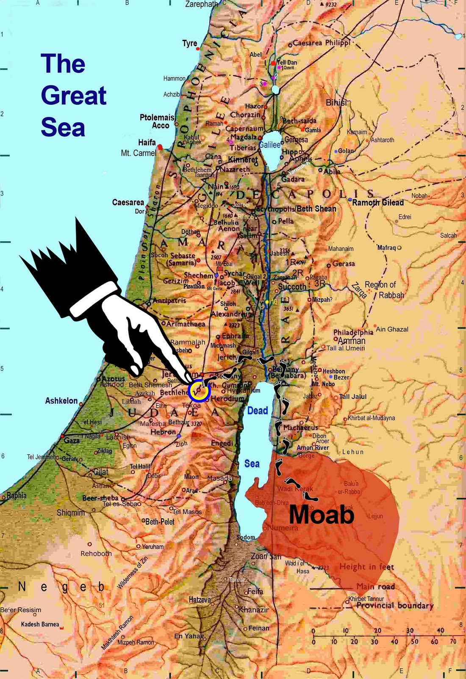

Slide 5
Insight #1:
In order to bring healing to the wounds of others one has to lay down their own rights and privileges to see redemption in God’s name

Slide 6
Insight #2:
In order to bring healing to the wounds of others one has to lay down their own status and resources to see redemption in God’s name

Slide 7
Week 13–
How God Redeems

