Slide 1
Week 33–
Redeeming the City

Slide 2
Withdraw, Isolate, Separate Yourself

Slide 3
Assimilate Yourself

Slide 4
Win as many people to Jesus as possible

Slide 5
Critical Question:
How should Christians interact and live in the culture they are a part of?

Slide 6
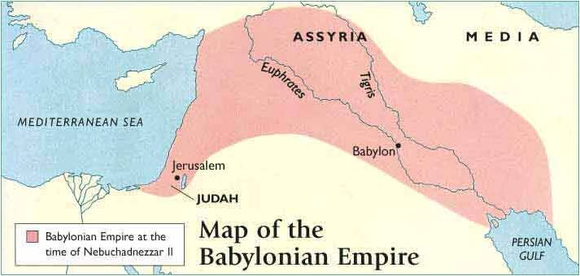

Slide 7
Babylonian Strategy:
To bring the best and smartest to Babylon. Let them see our wealth and greatness and eventually they will adopt our ways. Let them worship their god(s) as long as they worship the religion of tolerance.

Slide 8
Be the City of God to Babylon

Slide 9
City of Man:
Characterized by pride, power, trying to make a name for yourself, putting your own needs above others.

Slide 10
City of God:
Characterized by humility, grace, joy, and putting the needs of others above yourself.

Slide 11
Principle #1:
You can worship God faithfully right here in Babylon

Slide 12
Principle #2:
Pray for the city!

Slide 13
Principle #3:
Seek the peace of the city!

Slide 14
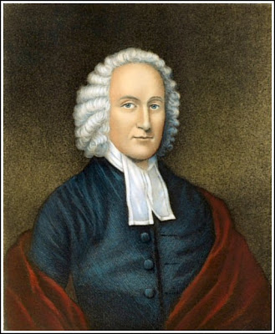
“If your highest love is your biological family then you will always choose your family’s good over the good of others. . . If your highest love is yourself then you will not meet the needs of others unless your needs are met.” – Jonathan Edwards

Slide 15
Don’t lose your distinctiveness as a Christian but also don’t allow your distinctiveness to drive you away from seeking God’s shalom for your city.

