Slide 1
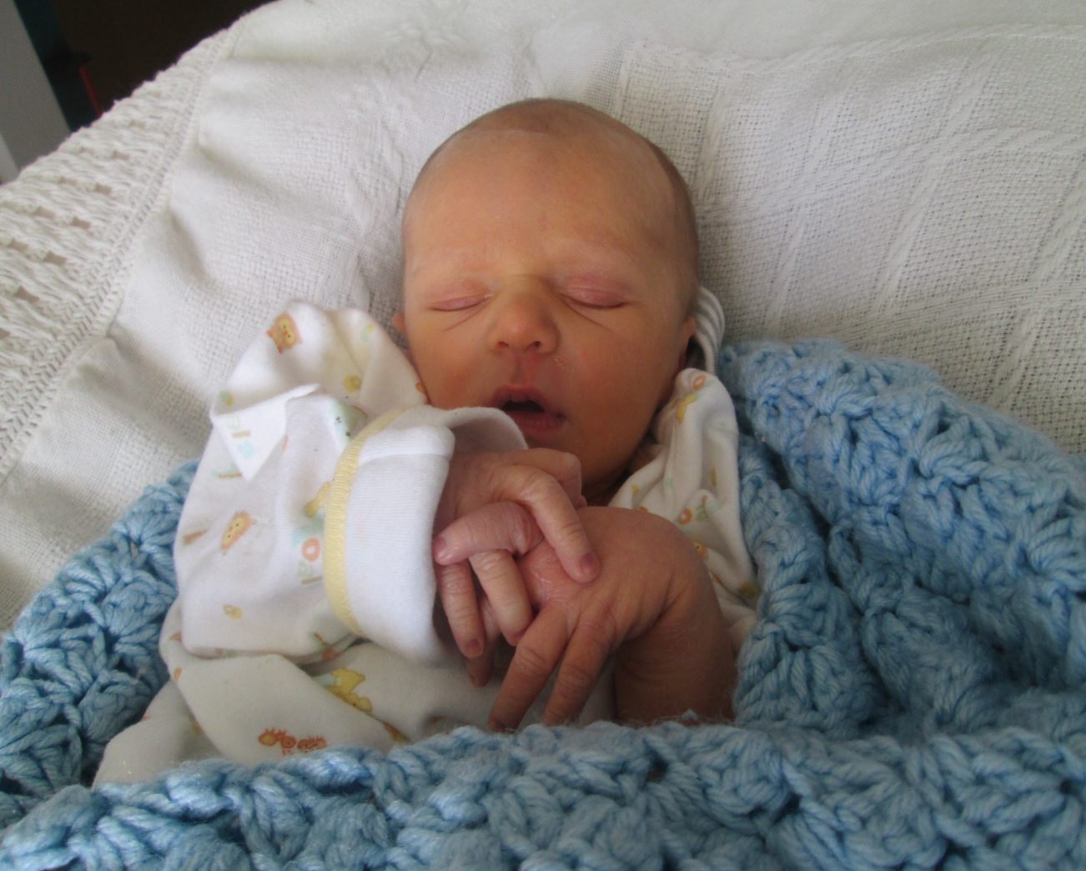
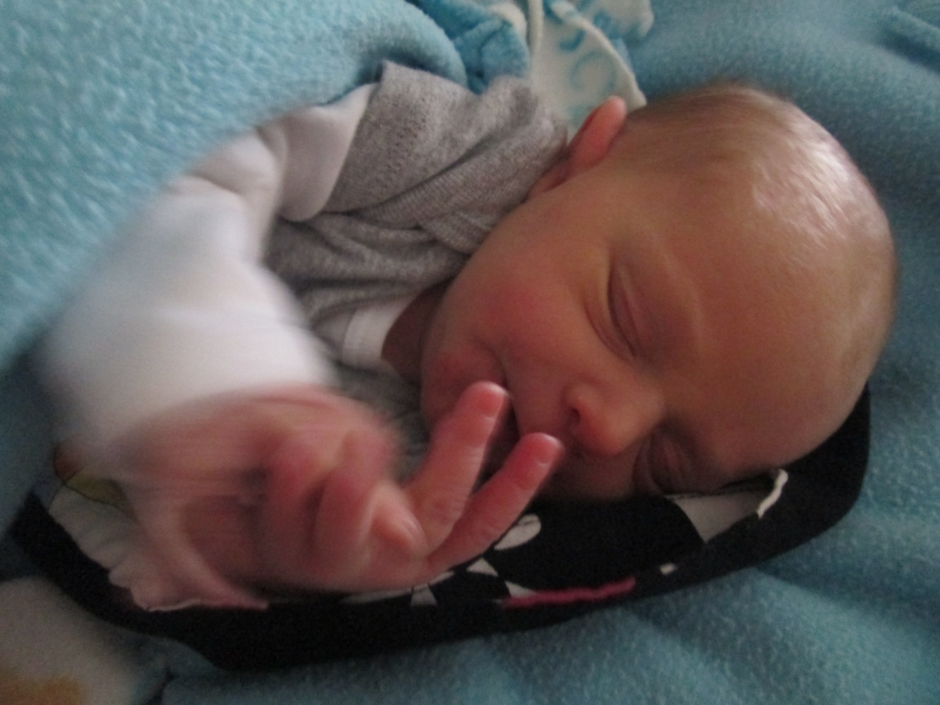
Courage Amadeus Mitchell

Slide 2
Week 50 –
What’s So Great About Jesus

Slide 3
You don’t need Jesus to do or give you anything more – you just need more of Jesus!

Slide 4
Anything that had a beginning had a beginning in Him so Jesus could not have had a beginning

Slide 5
the reordering and relinquishment of our lives

Slide 6
to join Jesus in His mission of reconciliation

