Slide 1
Week 4:
The Mission of a Disciple
(part three)

Slide 2
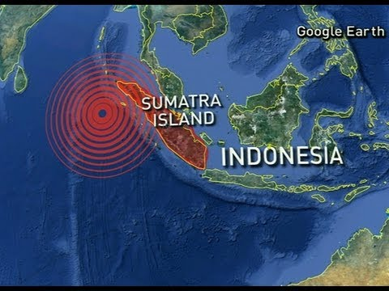

Slide 3
“We have all the trappings of the Church but we are missing the heart of Christ.”

Slide 4
To make sure every person on the planet hears about Jesus and sees His message lived out

Slide 5
Jesus’ authority is universal

Slide 6
Jesus’ authority is purposeful

Slide 7
“If you are not fishing for people then you are not following Jesus.”
– Dawson Trotman

Slide 8
Growing Christians do not grow alone

Slide 9
To make sure every person on the planet hears about Jesus and sees His message lived out

Slide 10
Biblical mission and biblical community are inseparable

Slide 11
“The person who loves their own dream of community will destroy community, but the person who loves those around them will experience community.” - Dietrich Bonhoeffer

Slide 12
“Who shall I disciple as Jesus did me?”
“And who will continue Jesus’ discipling of me?”

