Slide 1
Week 7:
How to Make Disciples
(part three)

Slide 2
Leaders are responsible to equip God’s people for works of service.

Slide 3
God’s people, not just the leaders, participate in doing the ministry of the church.

Slide 4
The goal of the works of service is to build up God’s people to maturity.

Slide 5
Where do I start?
1) A commitment to make disciples

Slide 6
Where do I start?
2) Pray

Slide 7
Where do I start?
3) Identify the spiritual needs of the person

Slide 8
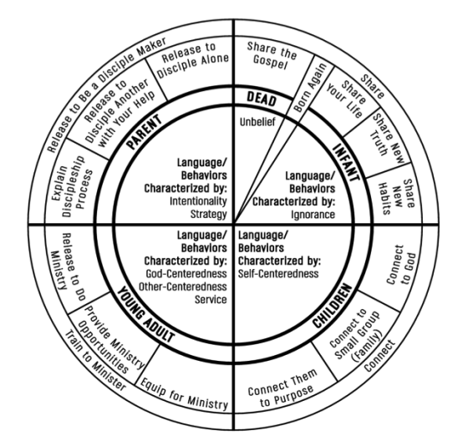
The 5 Stages of Discipleship

Slide 9
Spiritual growth often goes in cycles but is illustrated in a linear pattern to help us grasp the basic concept

Slide 10
The responsibility to multiply the life of Christ in someone never rests on you alone

Slide 11
The Spiritually Dead

Slide 12
Infants

Slide 13
Children

Slide 14
Young Adults

Slide 15
Parents

