Slide 1
Week 8:
How to Make Disciples
(part four)

Slide 2
Question:
When Jesus died there were around a couple hundred followers but by 300 A.D. there were at least 20 million. How do you explain this?

Slide 4
“Christianity did not grow because of miracle working in the marketplace, although there may have been much of that going on, or because Constantine said it should. . .”

Slide 5
“. . . Christianity did not grow because the martyrs gave it such credibility. That is not why it grew. It grew because Christians constituted an intense community and the primary means of its growth was through the united and motivated efforts of the growing numbers of Christians who invited their friends, relatives, and neighbors to share the good news.”

Slide 6
What is a disciple of Jesus?
A disciple of Jesus is someone who has changed their story to God’s, experience ongoing change in their life, and participates in His mission.

Slide 7
What is the mission of a disciple of Jesus?
To make sure every person on planet earth knows about Jesus and sees His message lived out.

Slide 8
How do we make disciples?
To multiply the life of Jesus in you to help them become like Him and do what He did.

Slide 9
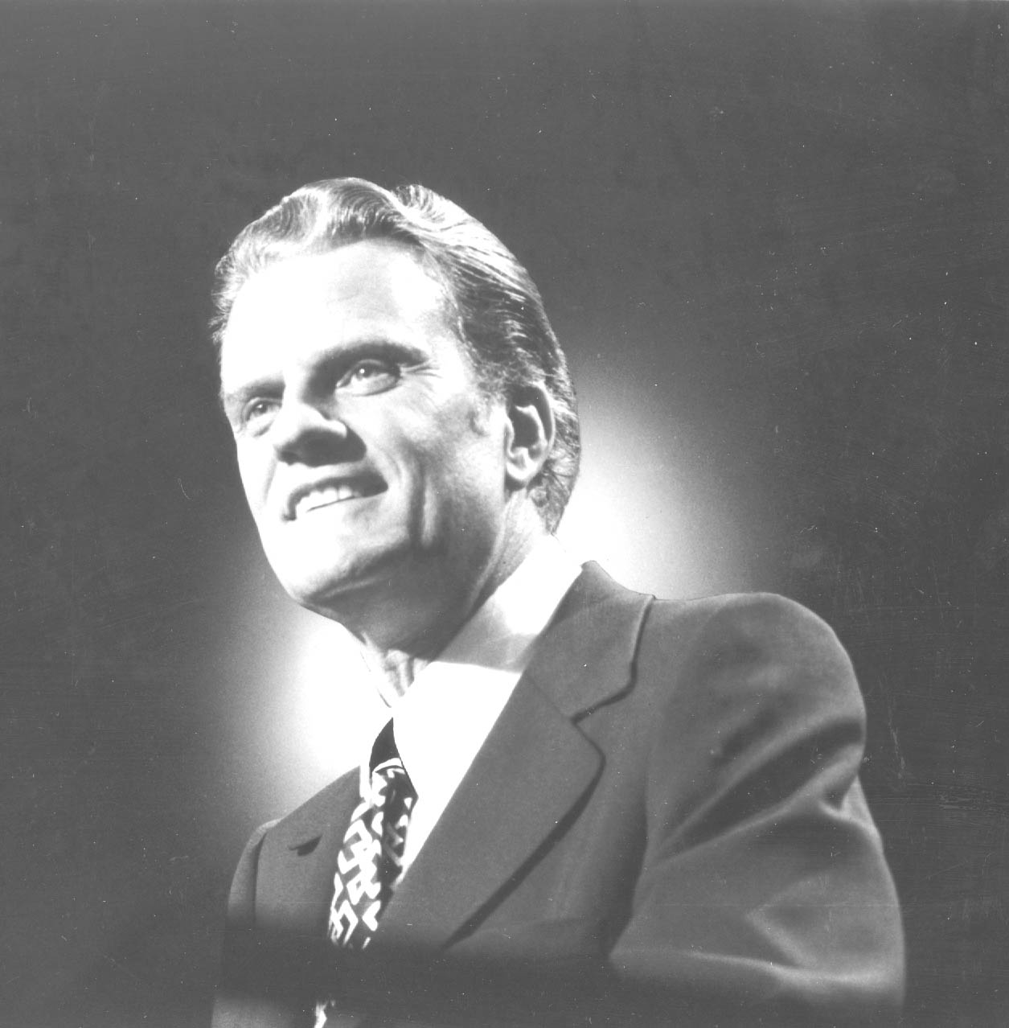
“One of the first verses of Scripture that Dawson Trotman encouraged me to memorize was 2 Timothy 2:2. This is like a mathematical formula for spreading the gospel and enlarging the church. Paul taught Timothy; Timothy shared what he knew with faithful men; these faithful men would then teach others also. And so the
process goes on and on. If every believer followed this pattern, the church could reach the entire world in one generation.” - Billy Graham

Slide 10
The baton of faith must be held onto tightly.

Slide 11
The baton of faith must be passed on

Slide 12
“The person without the Spirit does not accept the things that come from the Spirit of God, for they are foolishness to them, and they cannot understand them.” – 1 Corinthians 2:14

Slide 13
Week 8:
How to Make Disciples
(part four)

Slide 14
The baton of faith represents your commitment to be a link in the chain of 2 Timothy 2:2 as you multiply your faith in Jesus by God’s grace to others in an ongoing relationship.

