Slide 1
WEEK 1:
JUSTICE AS WORSHIP

Slide 2
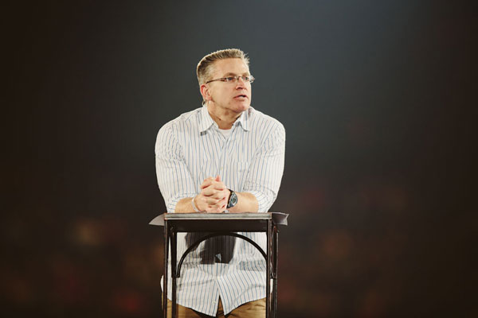
Gary Haugen

Slide 3
God is displeased with your worship of Him if it does not include the work of justice

Slide 4
“Truth is nowhere to be found, and whoever shuns evil becomes a prey. The LORD looked and was displeased that there was not justice. He saw that there was no one, He was appalled that there was no one to intervene.” – Isaiah 59:15-16

Slide 5
“The LORD loves righteousness and justice; the earth is full of His unfailing love.” – Psalm 33:5

Slide 6
“Righteousness and justice are the foundation of His throne.” – Psalm 97:2

Slide 7
“The LORD works righteousness and justice for all the oppressed.”
– Psalm 103:6

Slide 8
δικαιοσύνη
dikaiosyne

Slide 9
“Seek first His Kingdom and His righteousness and all these things will be given to you as well.”
– Matthew 6:33

Slide 10
“Seek first His Kingdom and His righteousness and His justice and all these things will be given to you as well.” – Matthew 6:33

Slide 11
“God made Him who had no sin to be sin for us, so that in Him we might become the righteousness and justice of God.” – 2 Cor. 5:21

Slide 12
What then is justice?

Slide 13
מִשְׁפָּט
mishpat

Slide 14
A call on God’s people to judge righteously AND to ensure that all experience their God-given rights to life, freedom, dignity, and protection of the fruits of their labor (i.e. making wrong things right for others)

Slide 15
“Woe to those who call evil good and good evil, who put darkness for light and light for darkness, who put bitter for sweet and sweet for bitter.” - Isaiah 5:20

Slide 16
Through Jesus, we are it

Slide 17
to make wrong things right for others

