Slide 1
Luke 6:12-16 (ESV)
¹² In these days he went out to the mountain to pray, and all night he continued in prayer to God. ¹³ And when day came, he called his disciples and chose from them twelve, whom he named apostles: ¹⁴ Simon, whom he named Peter, and Andrew his brother, and James and John, and Philip, and Bartholomew, ¹⁵ and Matthew, and Thomas, and James the son of Alphaeus, and Simon who was called the Zealot, ¹⁶ and Judas the son of James, and

Slide 2
Luke 6:12-16 (ESV)
Judas Iscariot, who became a traitor.

Slide 3
Mark 3:14 (ESV)
And he appointed twelve (whom he also named apostles) so that they might be with him and he might send them out to preach ¹⁵ and have authority to cast out demons.

Slide 4
Matthew 28:16-20 (ESV)
¹⁶ Now the eleven disciples went to Galilee, to the mountain to which Jesus had directed them. ¹⁷ And when they saw him they worshiped him, but some doubted. ¹⁸ And Jesus came and said to them, “All authority in heaven and on earth has been given to me. ¹⁹ Go therefore and make disciples of all nations, baptizing them in the name of the Father and of the Son and of the Holy Spirit, ²⁰ teaching them to observe all that I have

Slide 5
Matthew 28:16-20 (ESV)
commanded you. And behold, I am with you always, to the end of the age.”

Slide 6
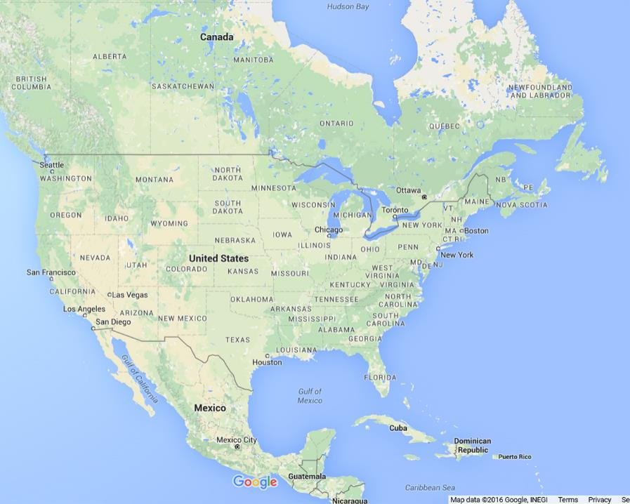

Slide 8
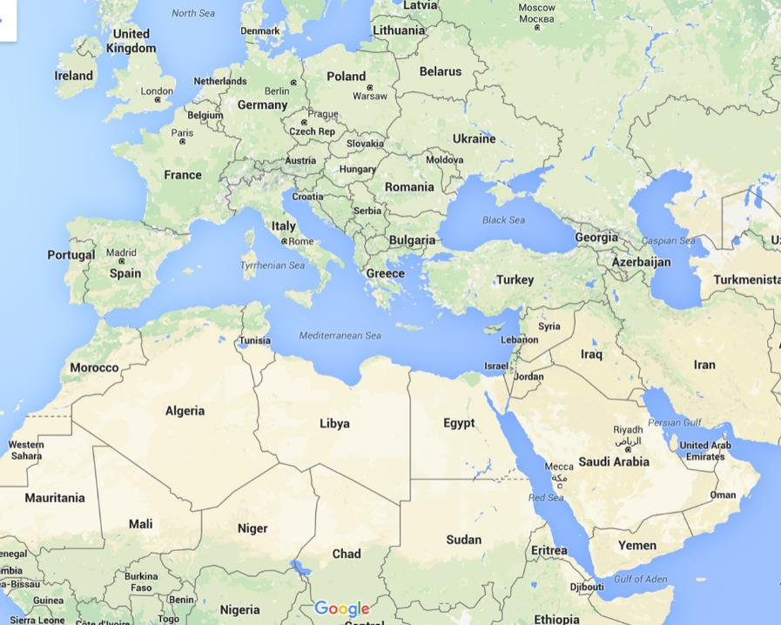

Slide 10
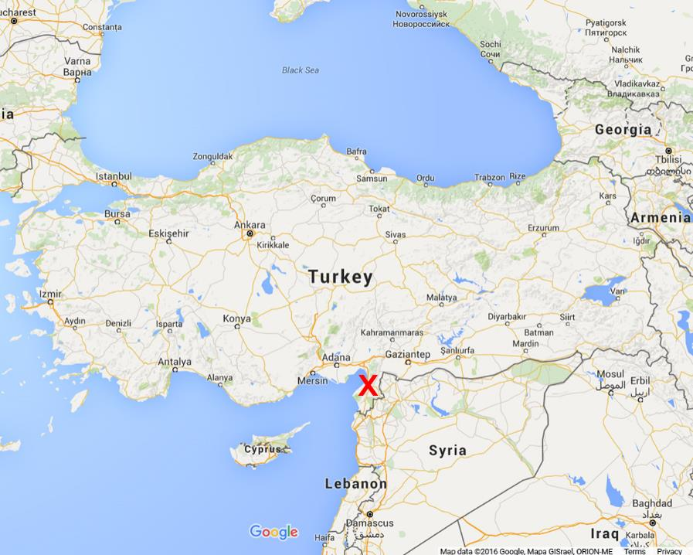

Slide 11
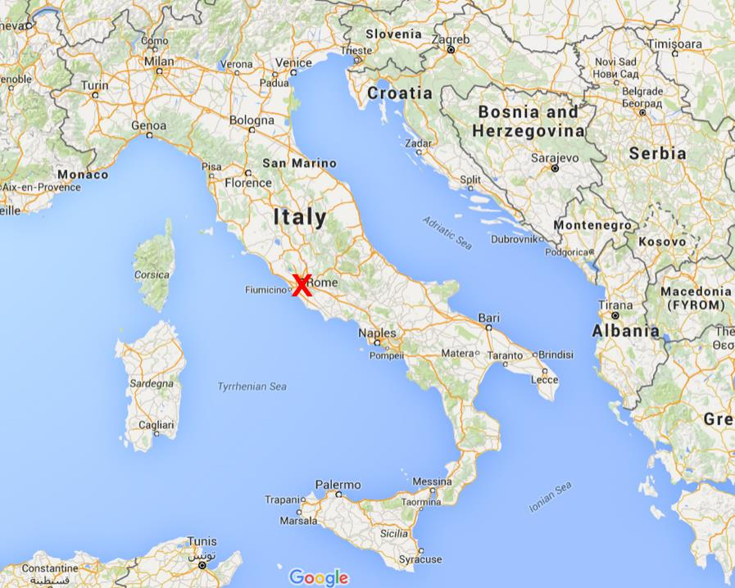

Slide 13
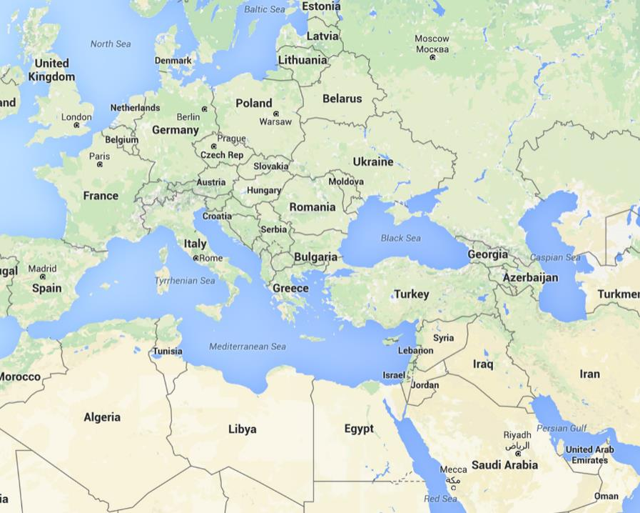

Slide 14
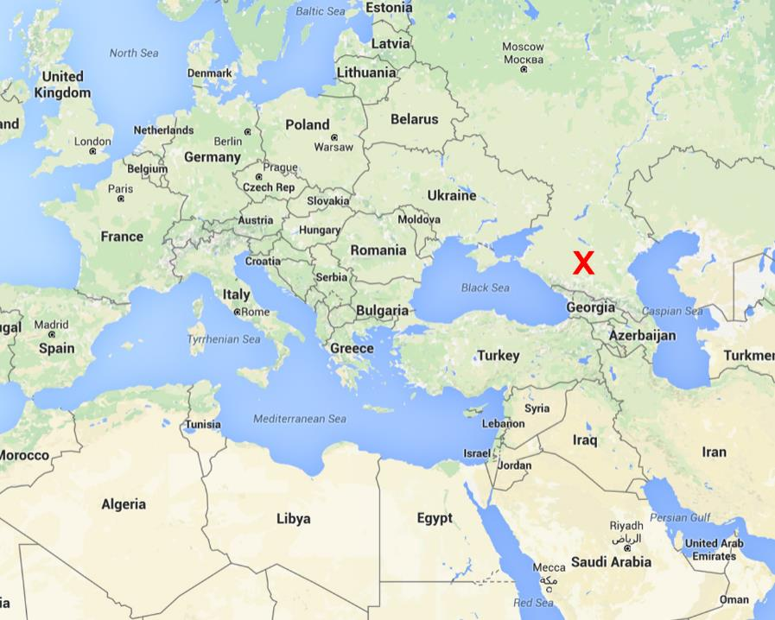

Slide 15
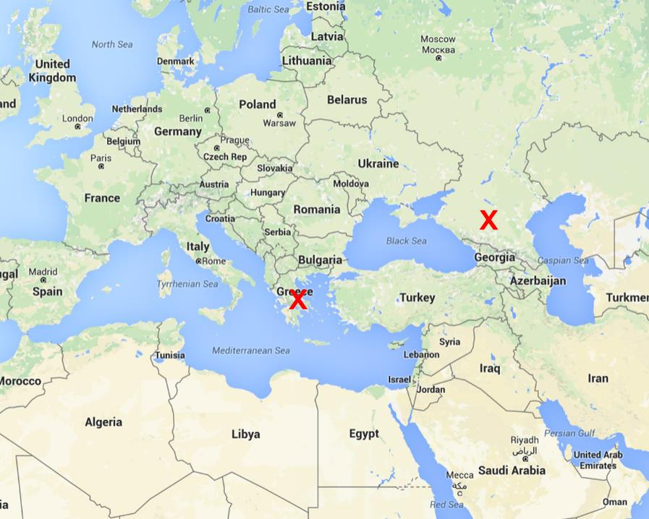

Slide 16
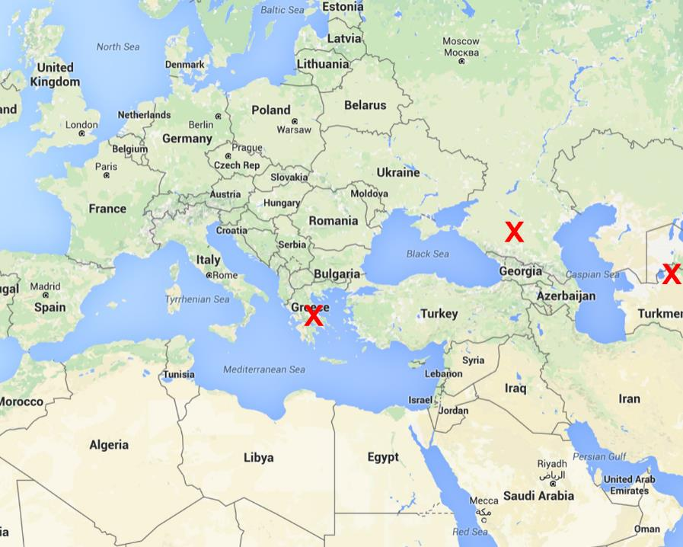

Slide 17
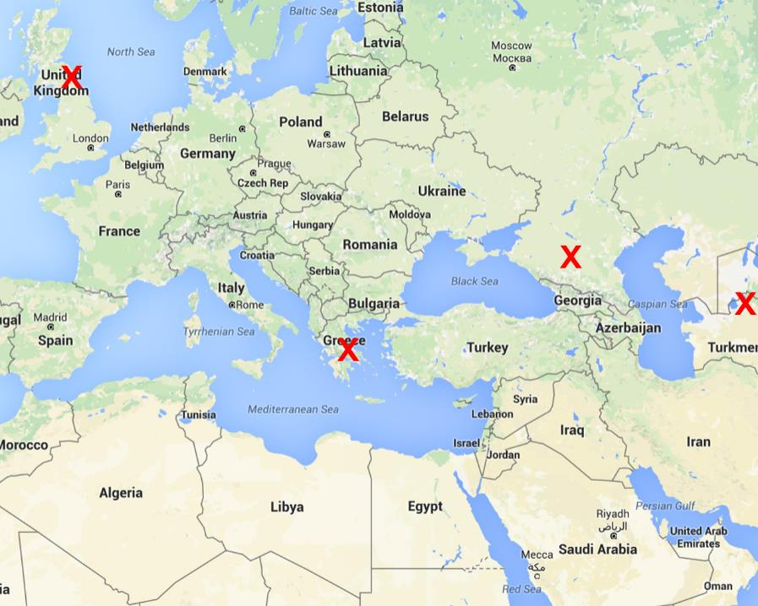

Slide 18
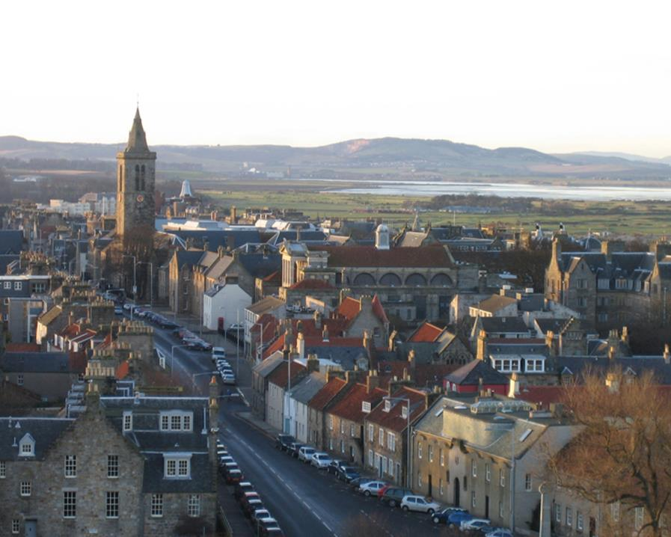

Slide 19
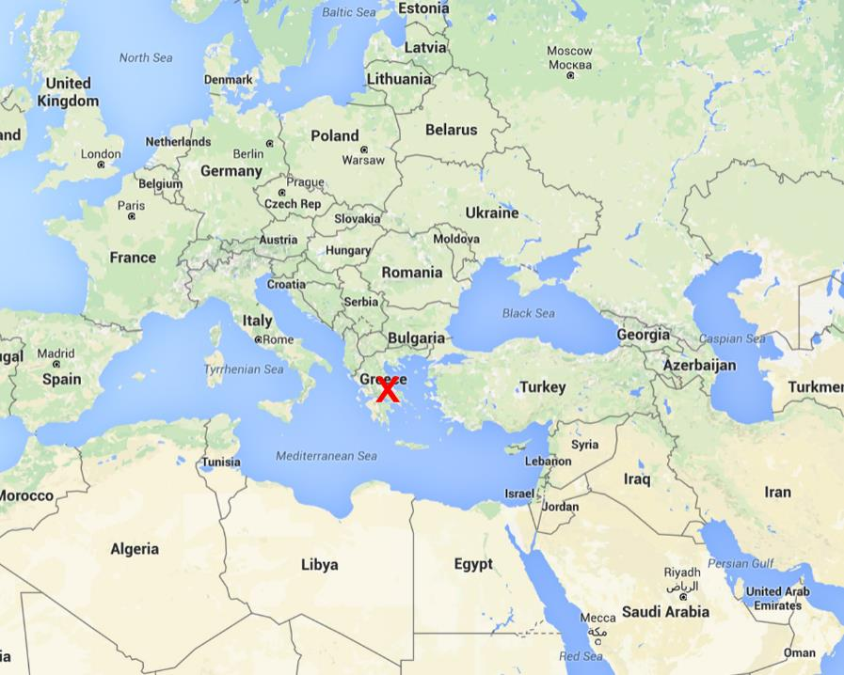

Slide 21
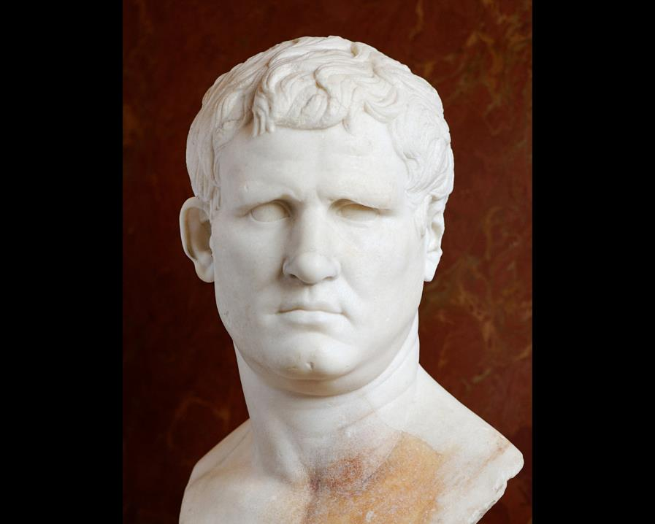

Slide 23
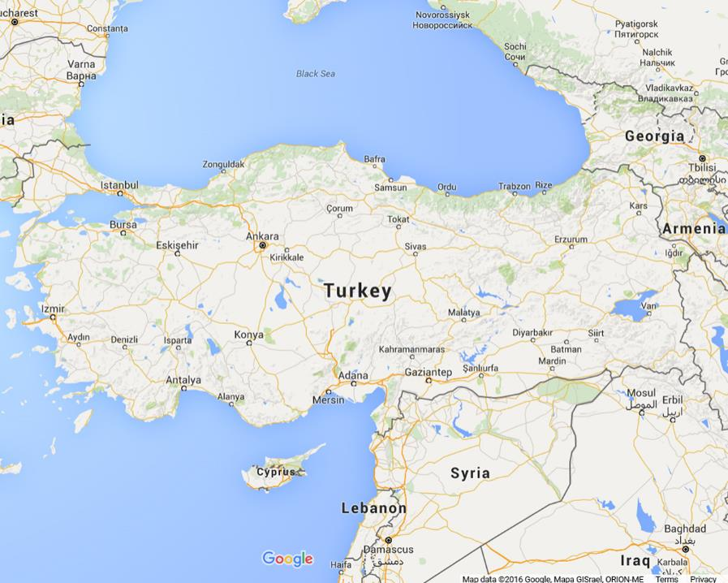

Slide 29
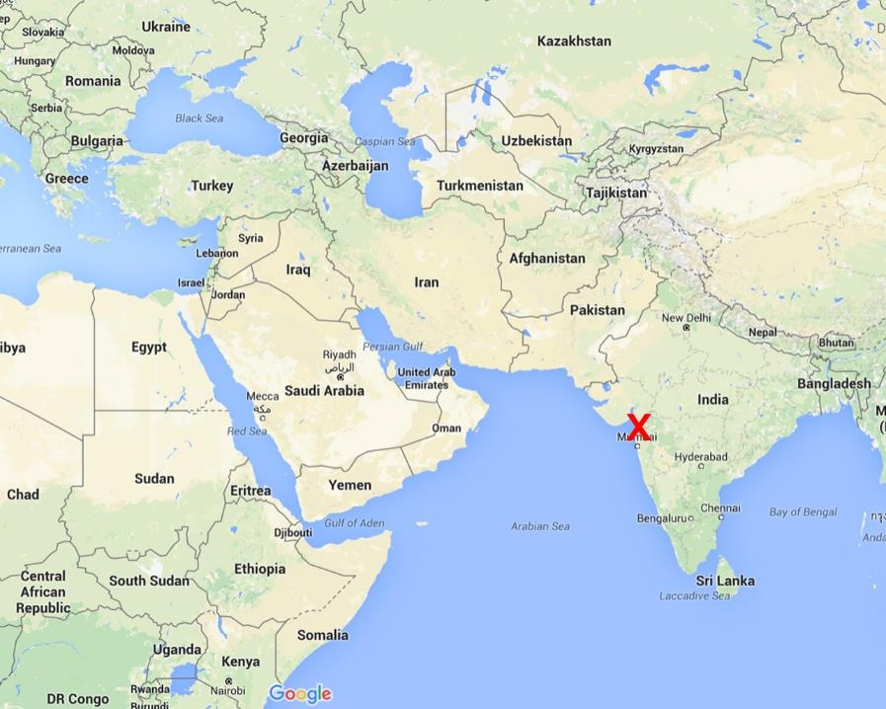

Slide 30
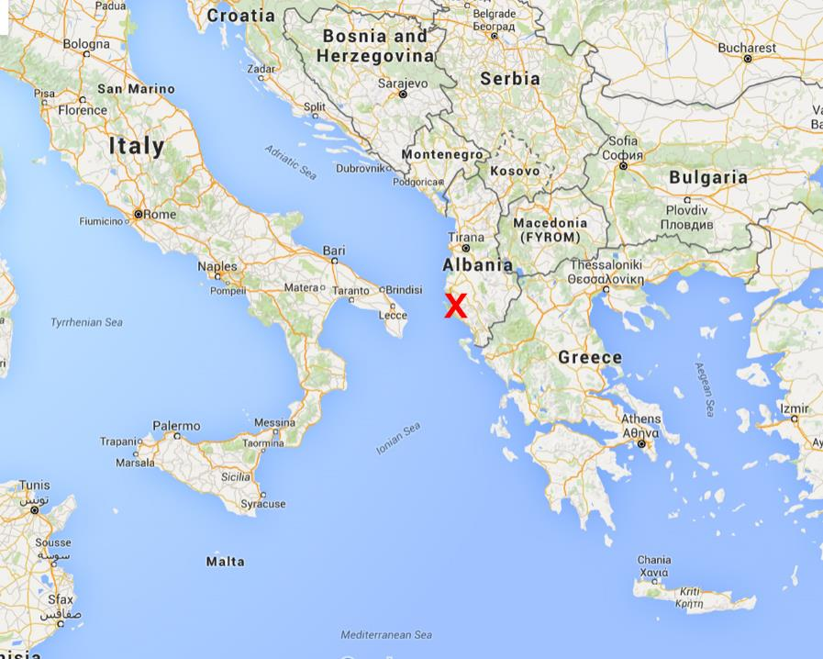

Slide 32
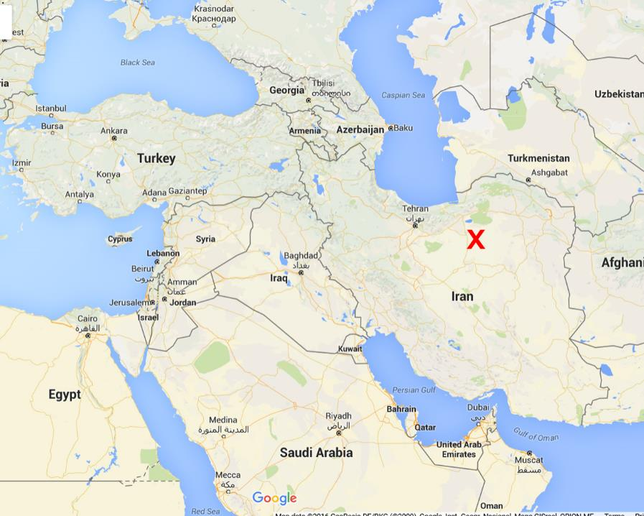

Slide 33
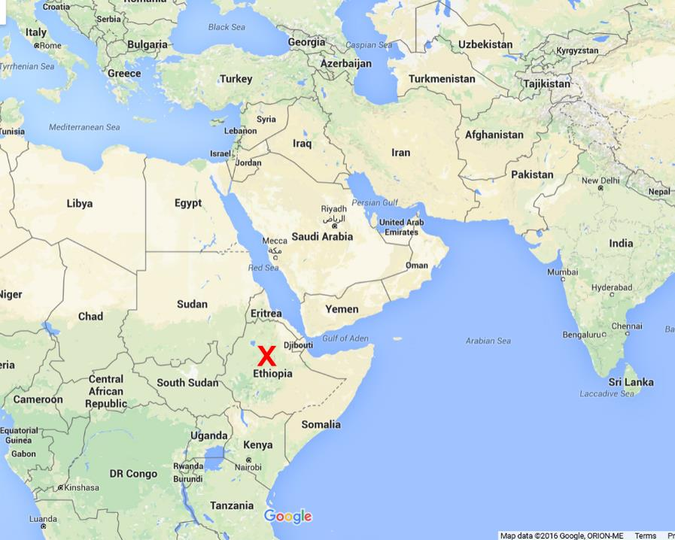

Slide 36
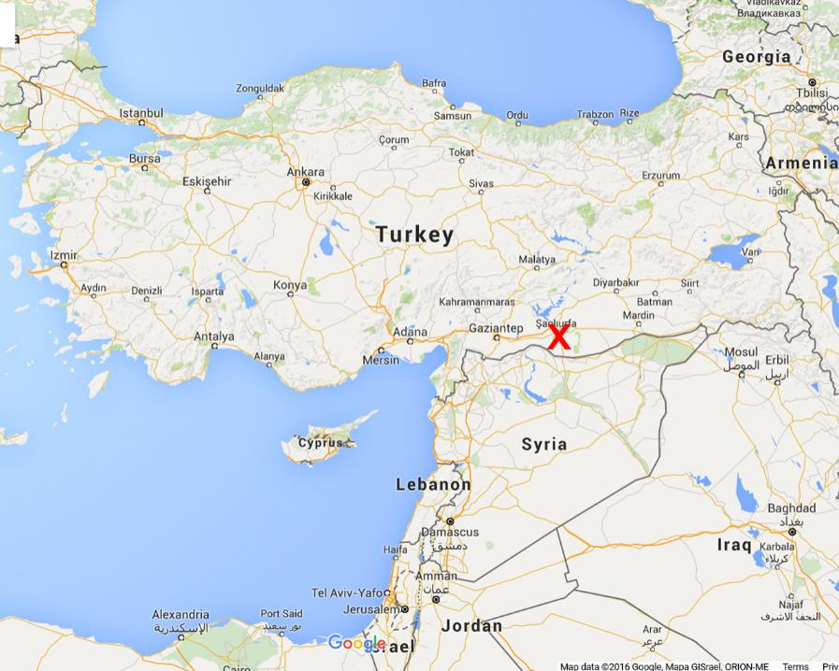

Slide 40
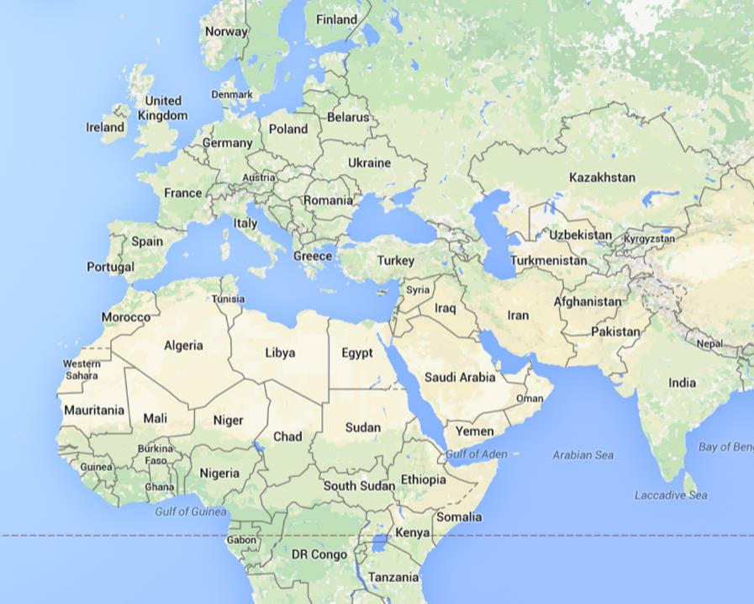

Slide 41
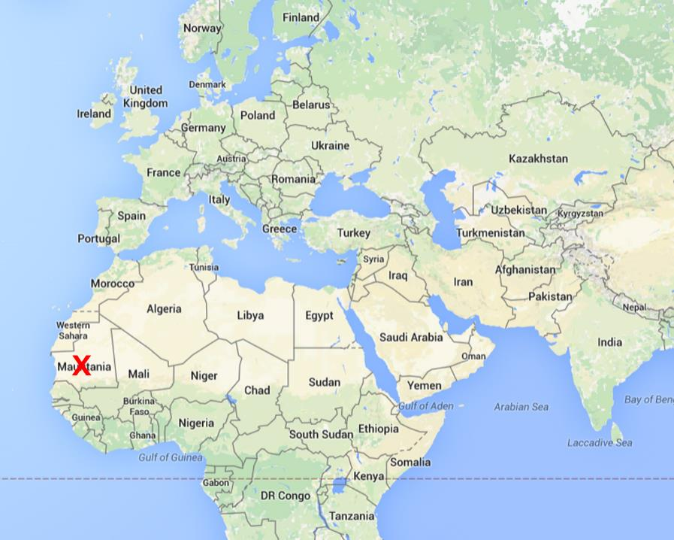

Slide 43
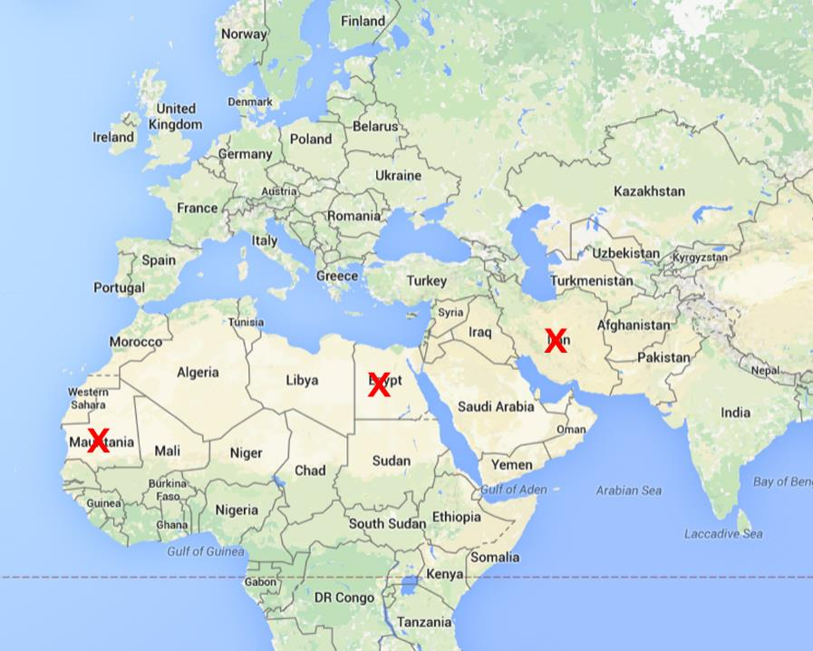

Slide 44
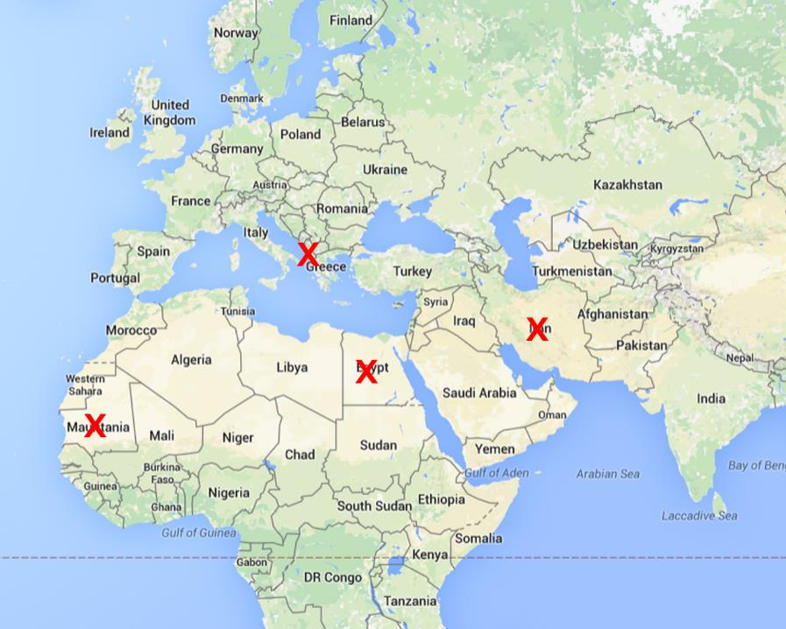

Slide 48
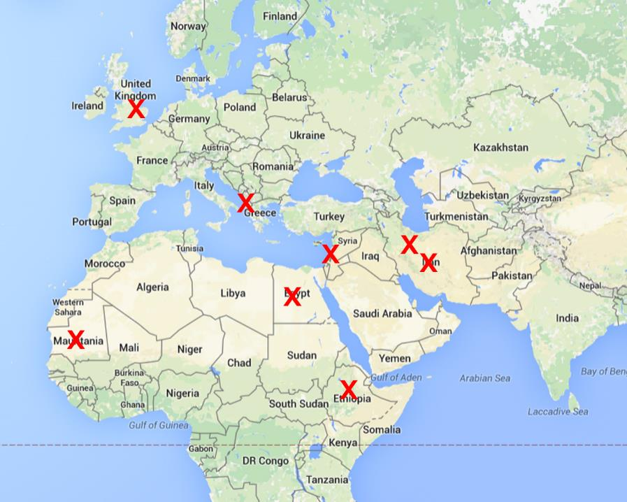

Slide 49
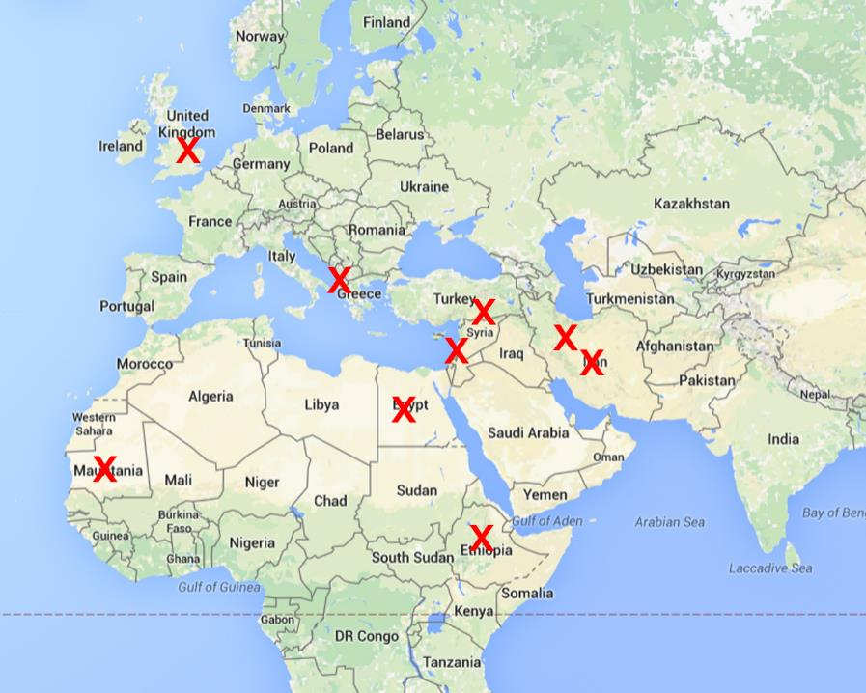

Slide 51
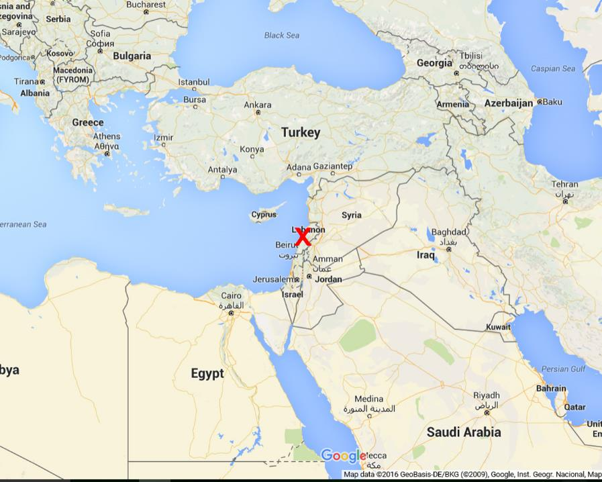

Slide 54
