Slide 1
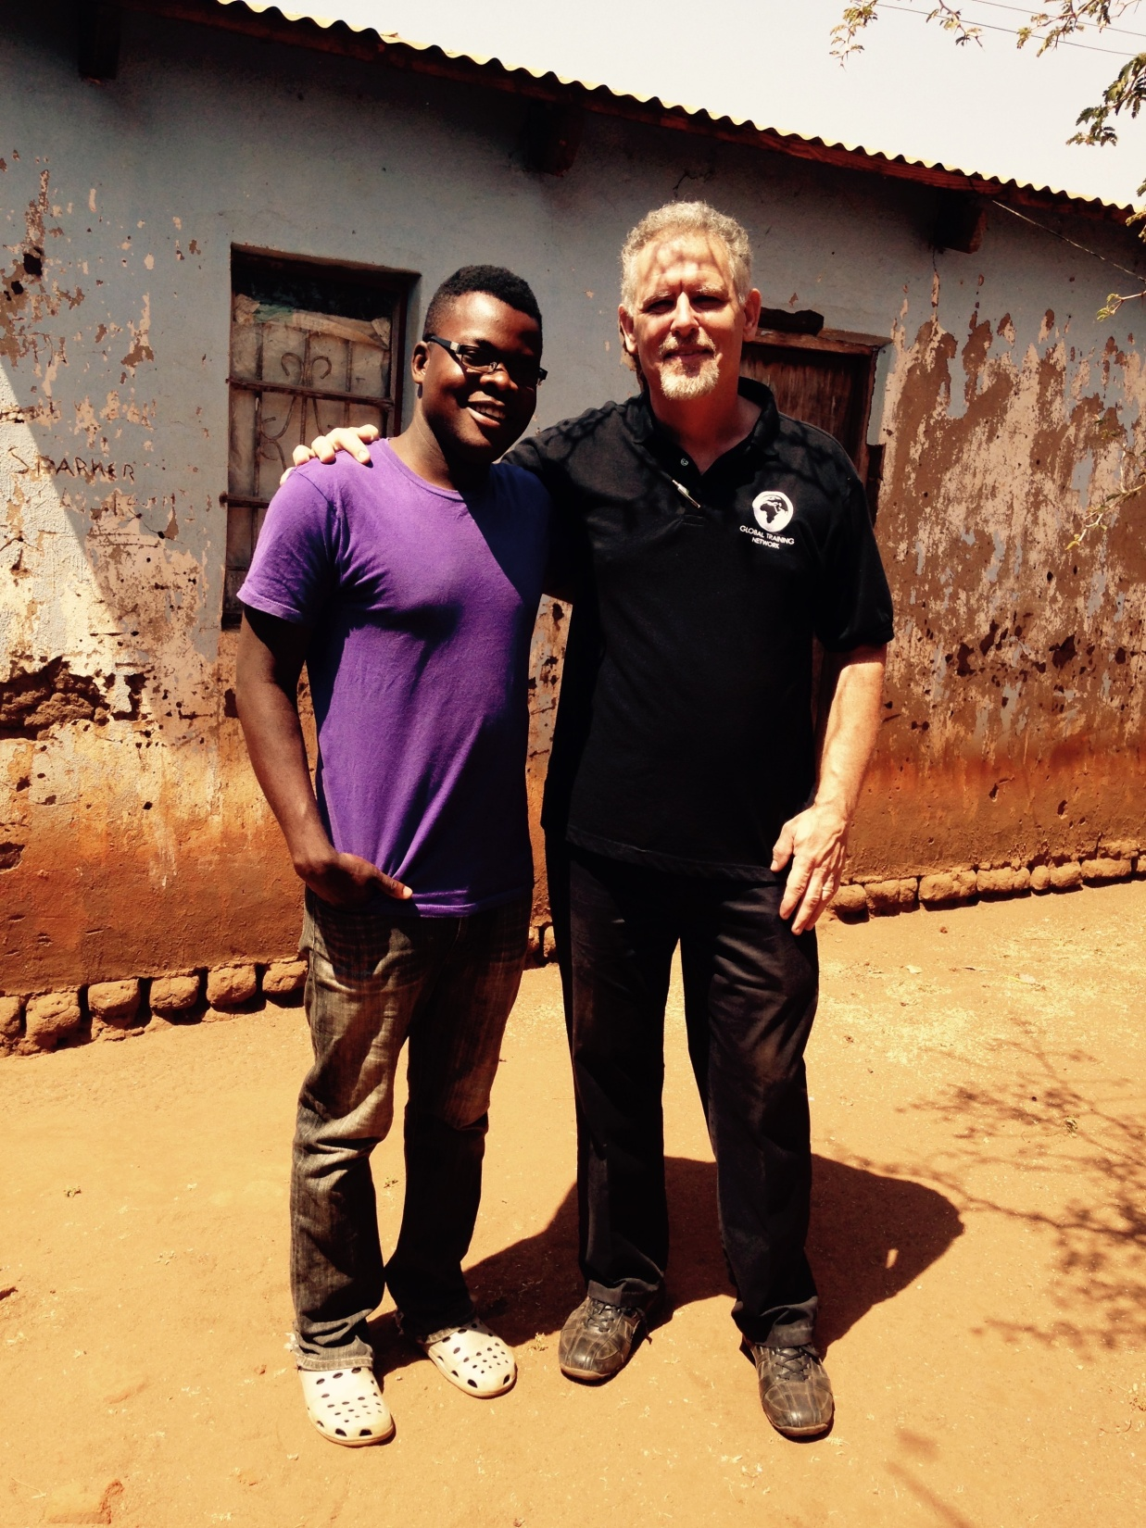
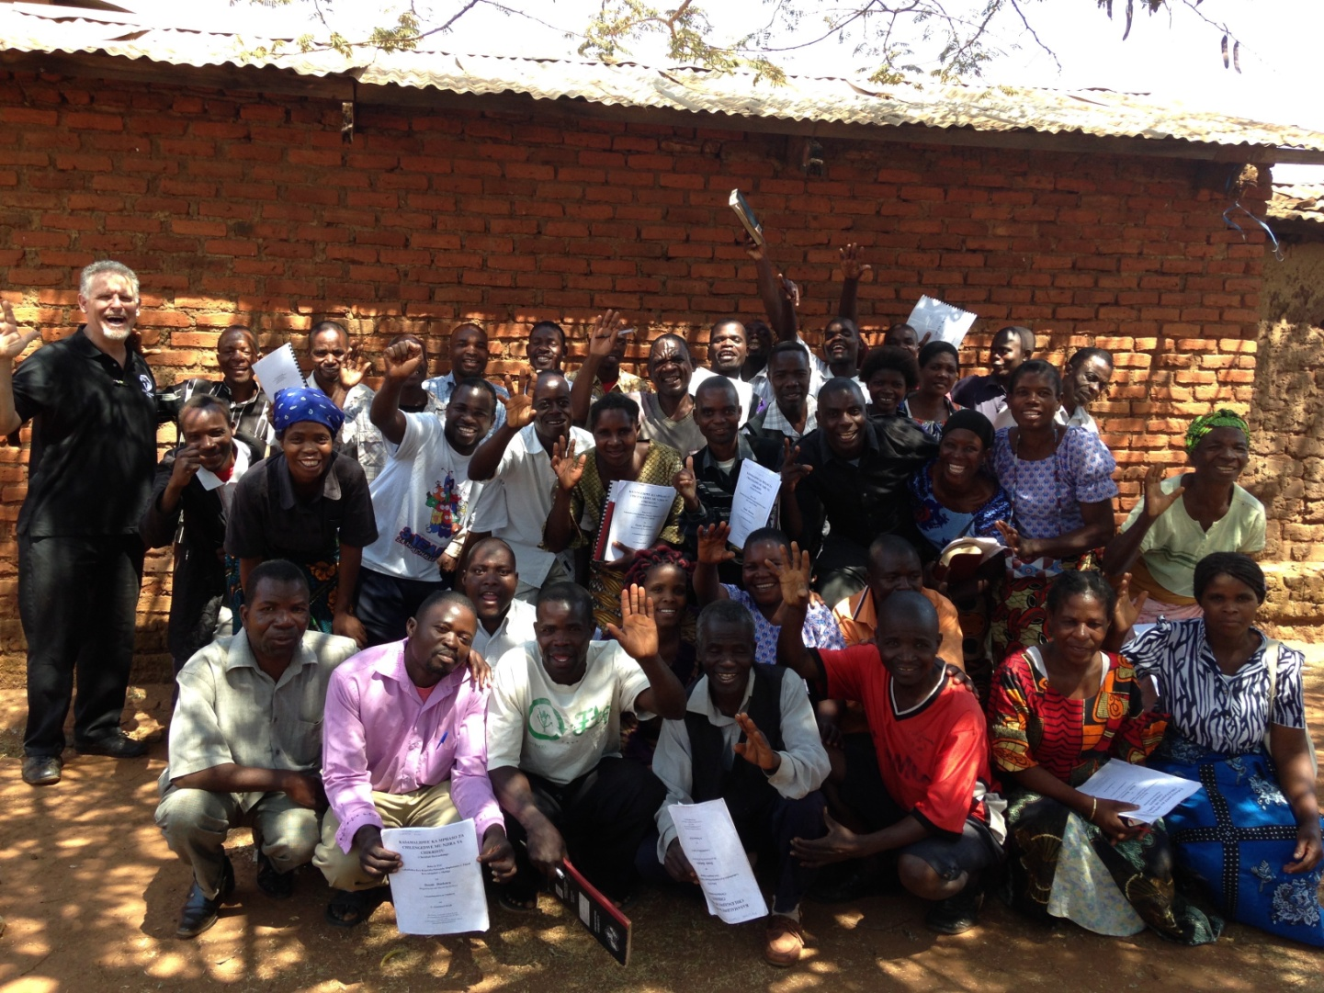

Slide 2
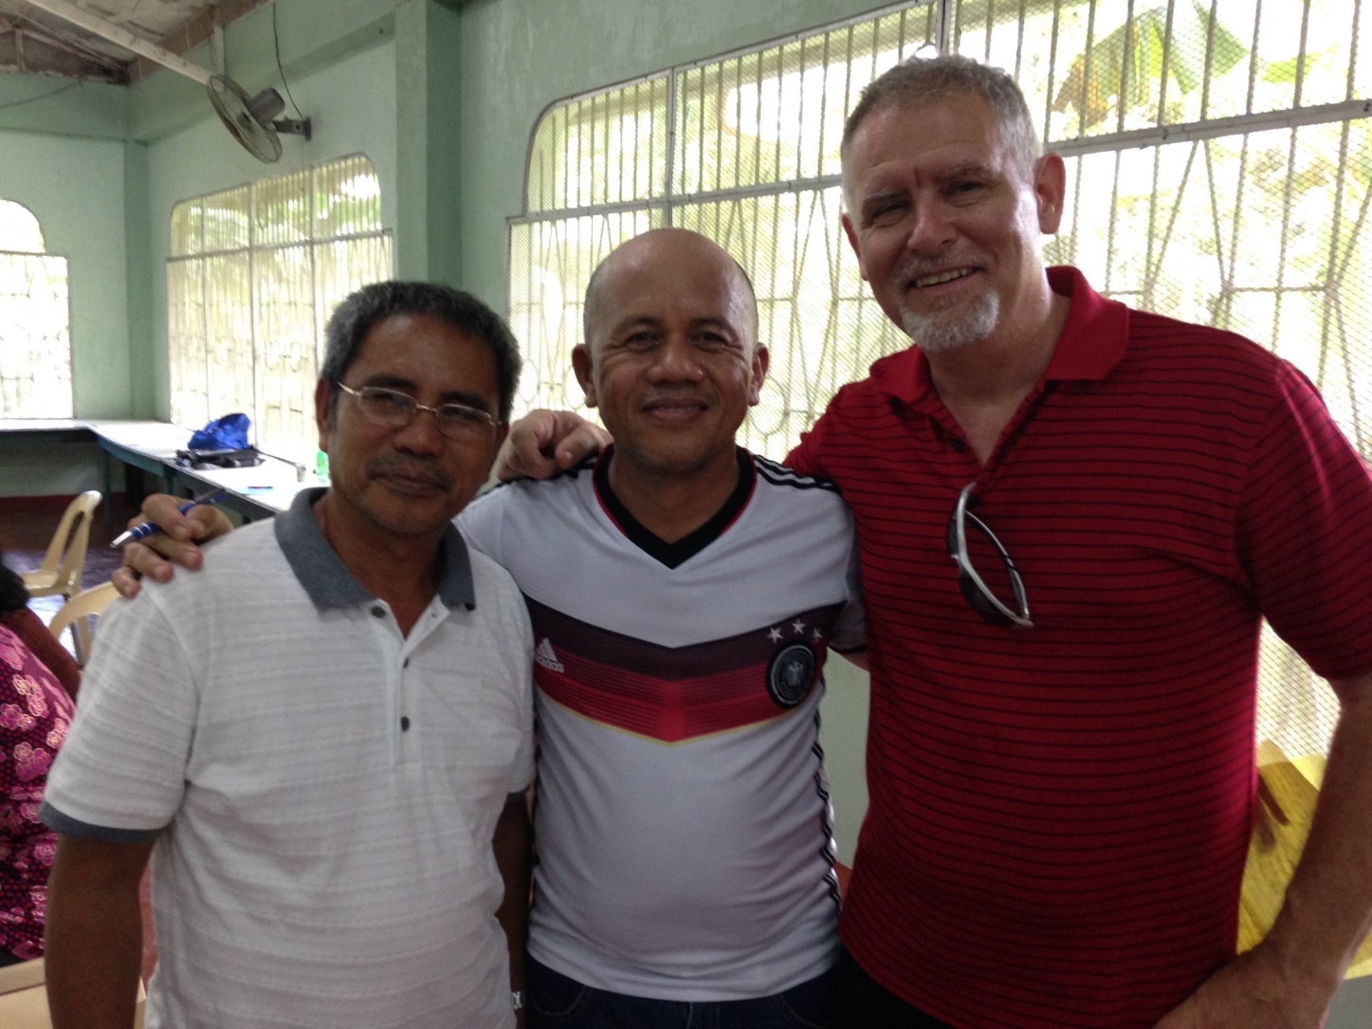
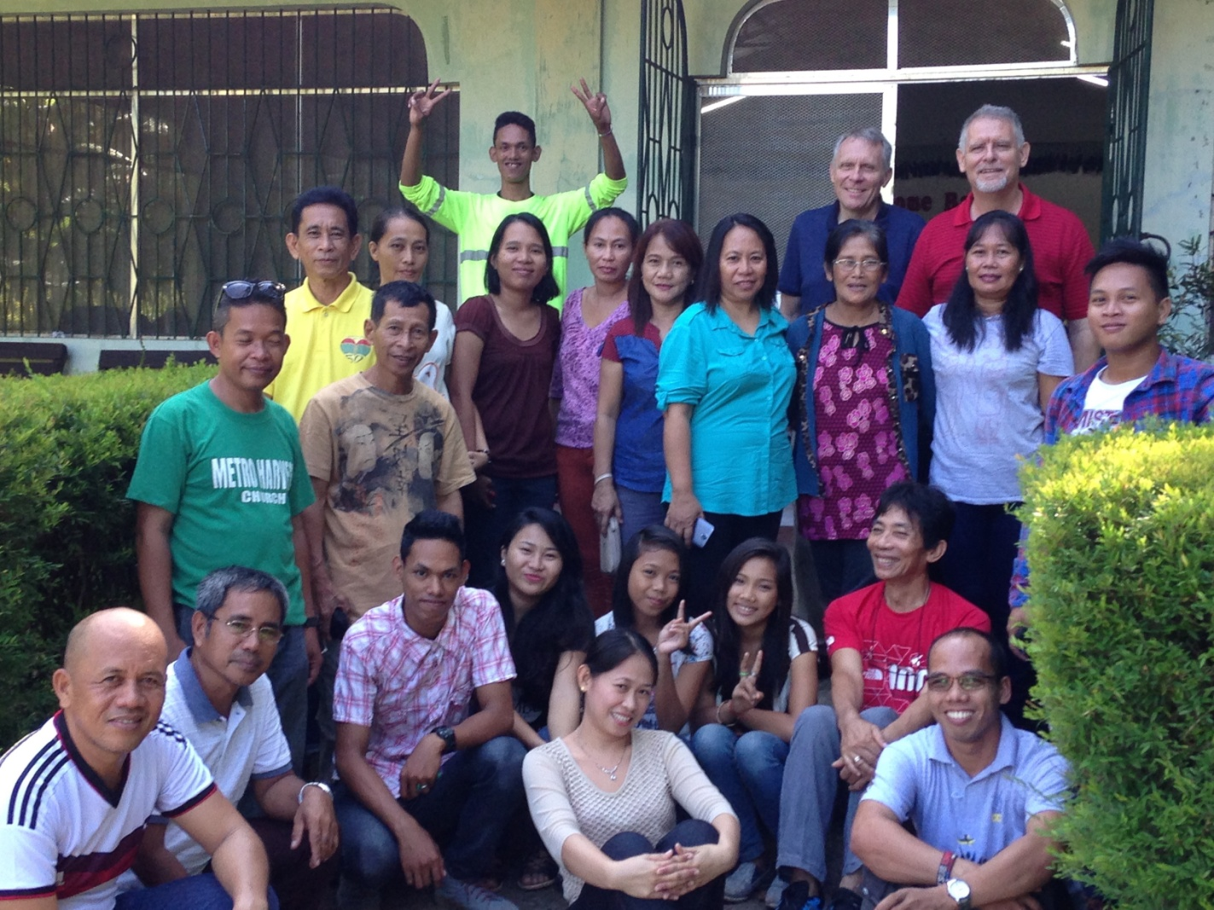

Slide 3
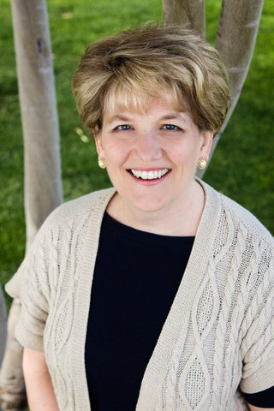

Slide 4
Mountain
Moving
FAITH

Slide 6
“You can
say to this
Mountain,”

Slide 7
“Move from here to There,”

Slide 8
“and
it WILL
Move;”

Slide 9
“Nothing will be IMPOSSIBLE
to you.”
-Matthew 17:21

Slide 11
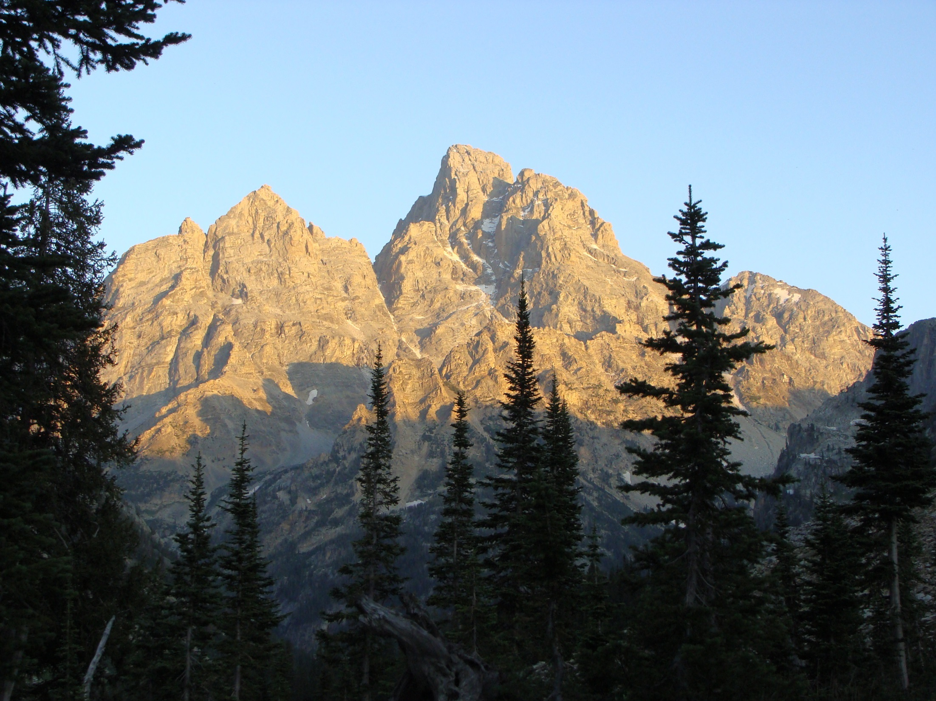

Slide 12
Persistent Problems

Slide 13
Frustrating Limitations

Slide 14
Evil Influences

Slide 15
Constant Demands

Slide 16
Continual Distractions

Slide 17
“The Kingdom of Heaven is like a mustard seed which a man took and planted in his field. Though it is the smallest of all seeds, yet when it grows it is the largest of garden plants, so that the birds of the air come and perch in its branches”
Matthew 13:31-32

Slide 19
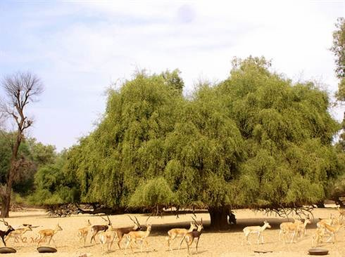

Slide 20
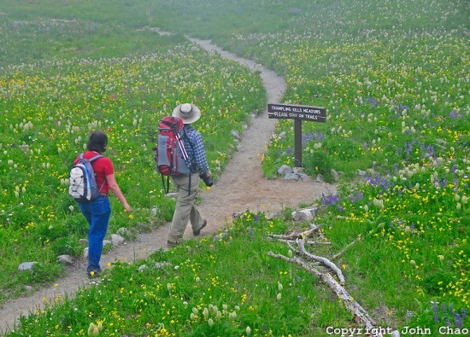

Slide 21
The Path of Faith

Slide 22
Speak to
Your Mountain!

Slide 23
Speaking
Equals
‘have faith’

Slide 24
‘Having Faith’
equals
‘Next Level Obedience’

Slide 25
“you can say
to this
Mountain”

Slide 26
“Move
from here
to There,”

Slide 27
“and
it WILL Move;”

Slide 28
The Path of Fear

Slide 29
Fear is the
belief that your mountain cannot be moved.

Slide 30
“If you
don’t Speak
to your
Mountain,”

Slide 31
“Your
Mountain
will Speak
to You!”

Slide 32
What is Your Mountain?

Slide 33
Who is doing the talking?

