Slide 1
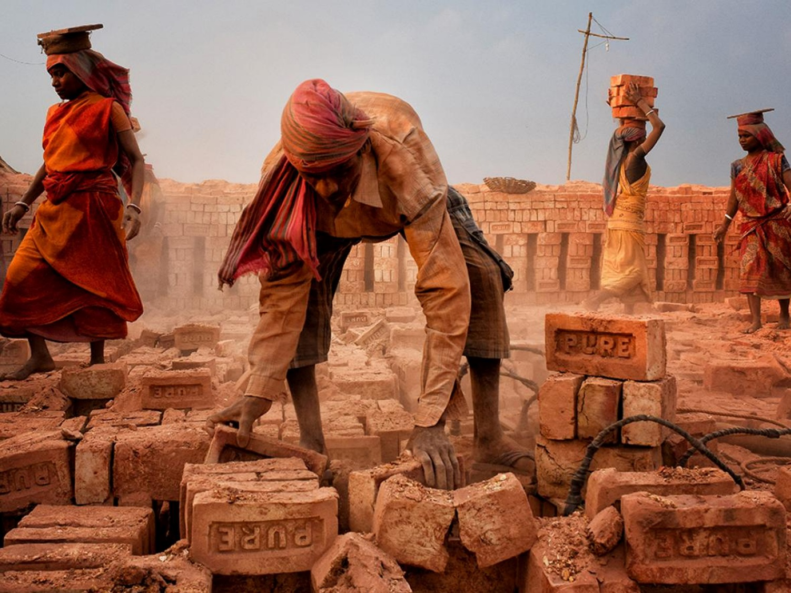
Freedom Sunday
Freedom Sunday

Slide 2
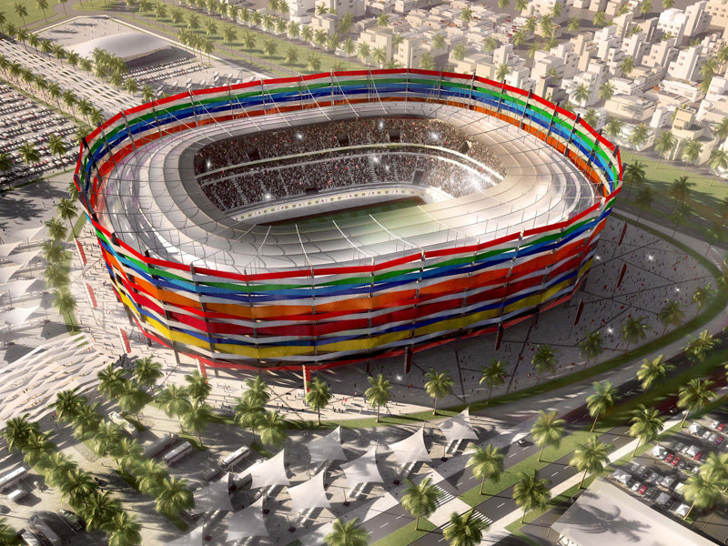

Slide 3
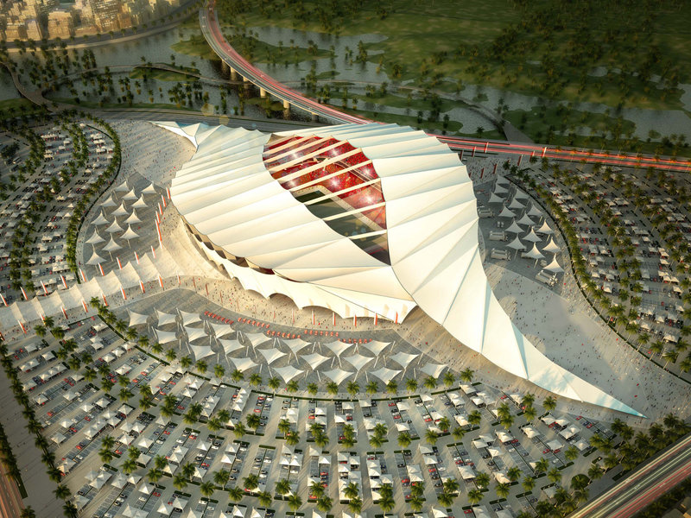

Slide 4
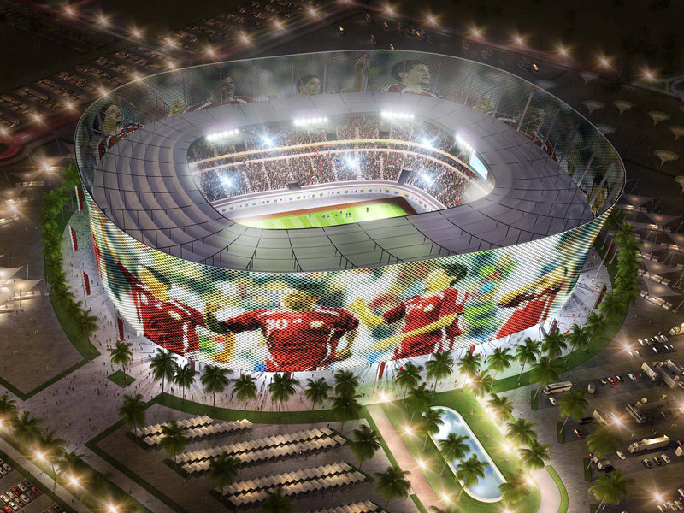

Slide 5
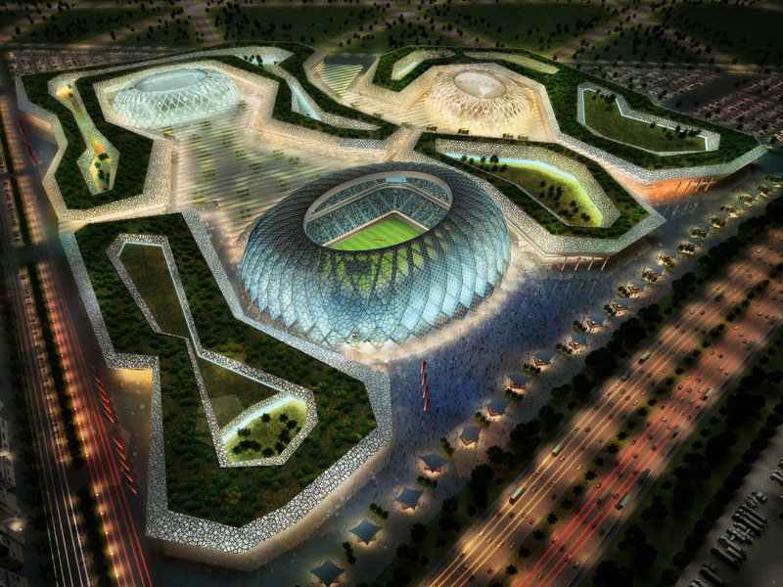

Slide 6
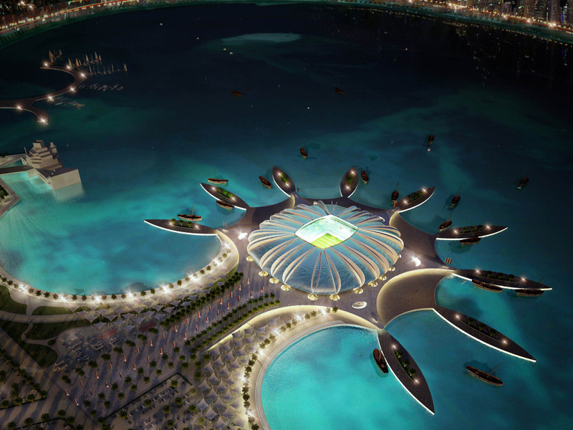

Slide 7
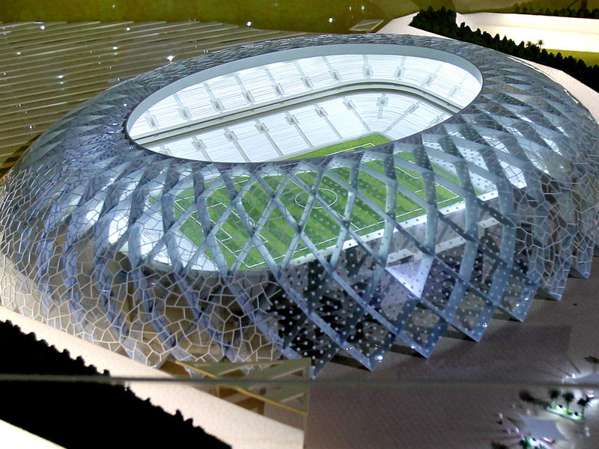

Slide 9
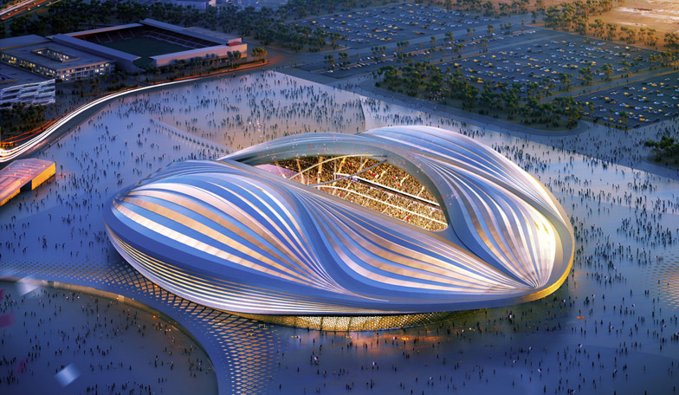

Slide 10
Freedom Sunday
Freedom Sunday

Slide 11
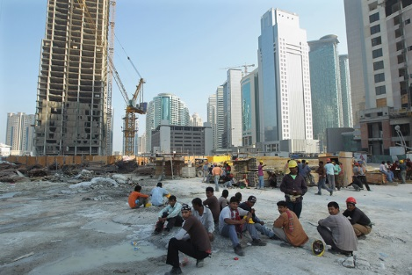

Slide 12
Freedom Sunday
Freedom Sunday

Slide 13
Ecclesiastes 4:1-2 (ESV)
4 Again I saw all the oppressions that are done under the sun. And behold, the tears of the oppressed, and they had no one to comfort them! On the side of their oppressors there was power, and there was no one to comfort them. ² And I thought the dead who are already dead more fortunate than the living who are still alive.

Slide 14
Freedom Sunday
Freedom Sunday

Slide 15
Isaiah 1:17 (ESV)
¹⁷ learn to do good; seek justice, correct oppression; bring justice to the fatherless, plead the widow's cause.

Slide 16
Freedom Sunday
Freedom Sunday

Slide 17
Luke 4:16-21 (ESV)
¹⁶ And he came to Nazareth, where he had been brought up. And as was his custom, he went to the synagogue on the Sabbath day, and he stood up to read. ¹⁷ And the scroll of the prophet Isaiah was given to him. He unrolled the scroll and found the place where it was written,
¹⁸ “The Spirit of the Lord is upon me, because he has anointed me to proclaim good news to the poor. He has sent me to proclaim liberty to

Slide 18
Luke 4:16-21 (ESV)
the captives and recovering of sight to the blind, to set at liberty those who are oppressed,¹⁹ to proclaim the year of the Lord's favor.”
²⁰ And he rolled up the scroll and gave it back to the attendant and sat down. And the eyes of all in the synagogue were fixed on him. ²¹ And he began to say to them, “Today this Scripture has been fulfilled in your hearing.”

Slide 19
Freedom Sunday
Freedom Sunday

Slide 20
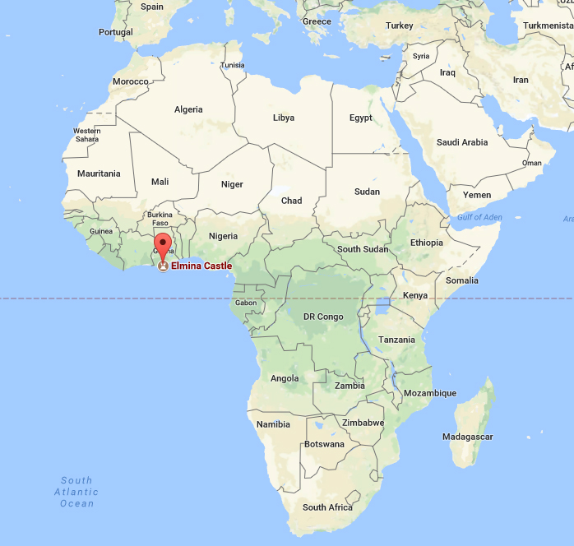

Slide 21
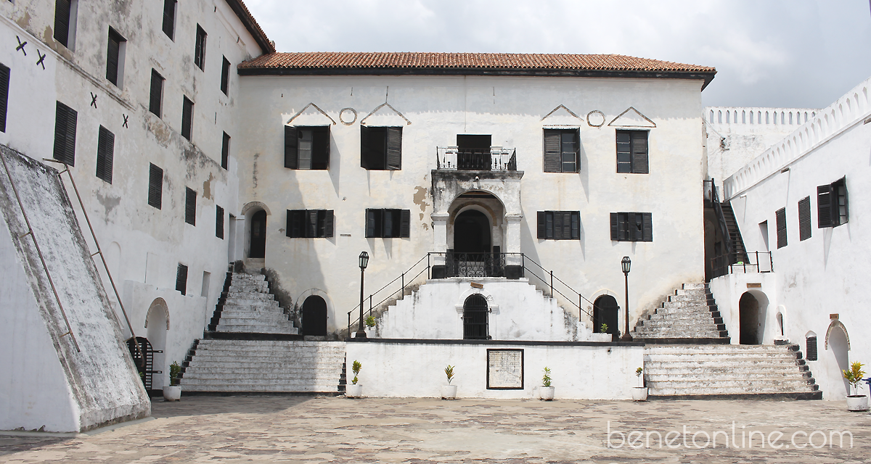

Slide 22
Freedom Sunday
Freedom Sunday

Slide 24
Freedom Sunday
Freedom Sunday

